Slide 1
CSE1142 – C Data Structures
Adapted from Dr. Sanem Arslan Yılmaz & Pearson Education.

Slide 2
Overview

Slide 3
12.1 Introduction
We have studied fixed-size data structures such as arrays and structs.
This lecture introduces dynamic data structures with sizes that grow and shrink at execution time.
  Linked lists are collections of data items “lined up in a row”—insertions and deletions are made anywhere in a linked list.
  Stacks are important in compilers and operating systems—insertions and deletions are made only at one end of a stack—its top.
  Queues represent waiting lines; insertions are made only at the back (also referred to as the tail) of a queue and deletions are made only from the front (also referred to as the head) of a queue.
Each of these data structures has many other interesting applications.

Slide 4
12.2 Self-Referential Structures
Recall that a self-referential structure contains a pointer member that points to a structure of the same structure type.
For example, the definition
    struct node {
    int data;
    struct node *nextPtr;
    };
defines a type, struct node.
A structure of type struct node has two members—integer member data and pointer member nextPtr.

Slide 5
12.2 Self-Referential Structures (Cont.)
nextPtr
  points to a structure of type struct node
  referred to as a link
    Ties a node to another node.
Self-referential structures can be linked together to form useful data structures such as lists, queues and stacks.

Slide 6
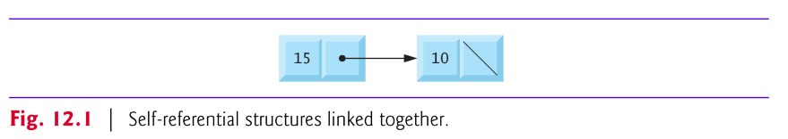
12.2 Self-Referential Structures (Cont.)
Figure 12.1 illustrates two self-referential structure objects linked together to form a list.
A NULL pointer normally indicates the end of a data structure just as the null character indicates the end of a string.

Slide 7
12.3 Dynamic Memory Allocation
Dynamic Memory Allocation
  the ability for a program to obtain more memory space at execution time to hold new nodes, and to release space no longer needed.
Functions malloc and free, and operator sizeof, are essential to dynamic memory allocation.

Slide 8
12.3 Dynamic Memory Allocation (Cont.)
void * malloc (int size)
  takes as an argument the number of bytes to be allocated
    Use sizeof to determine the size of an object
  returns a pointer of type void * (pointer to void)
    void * pointer may be assigned to any pointer type.
  Example:
  newPtr = malloc(sizeof(struct node));
The allocated memory is not initialized.
If no memory is available, malloc returns NULL.

Slide 9
12.3 Dynamic Memory Allocation (Cont.)
void free (void *ptr)
  deallocates memory allocated by malloc
  Takes a pointer as an argument
  Example:
  free(newPtr);

Slide 10
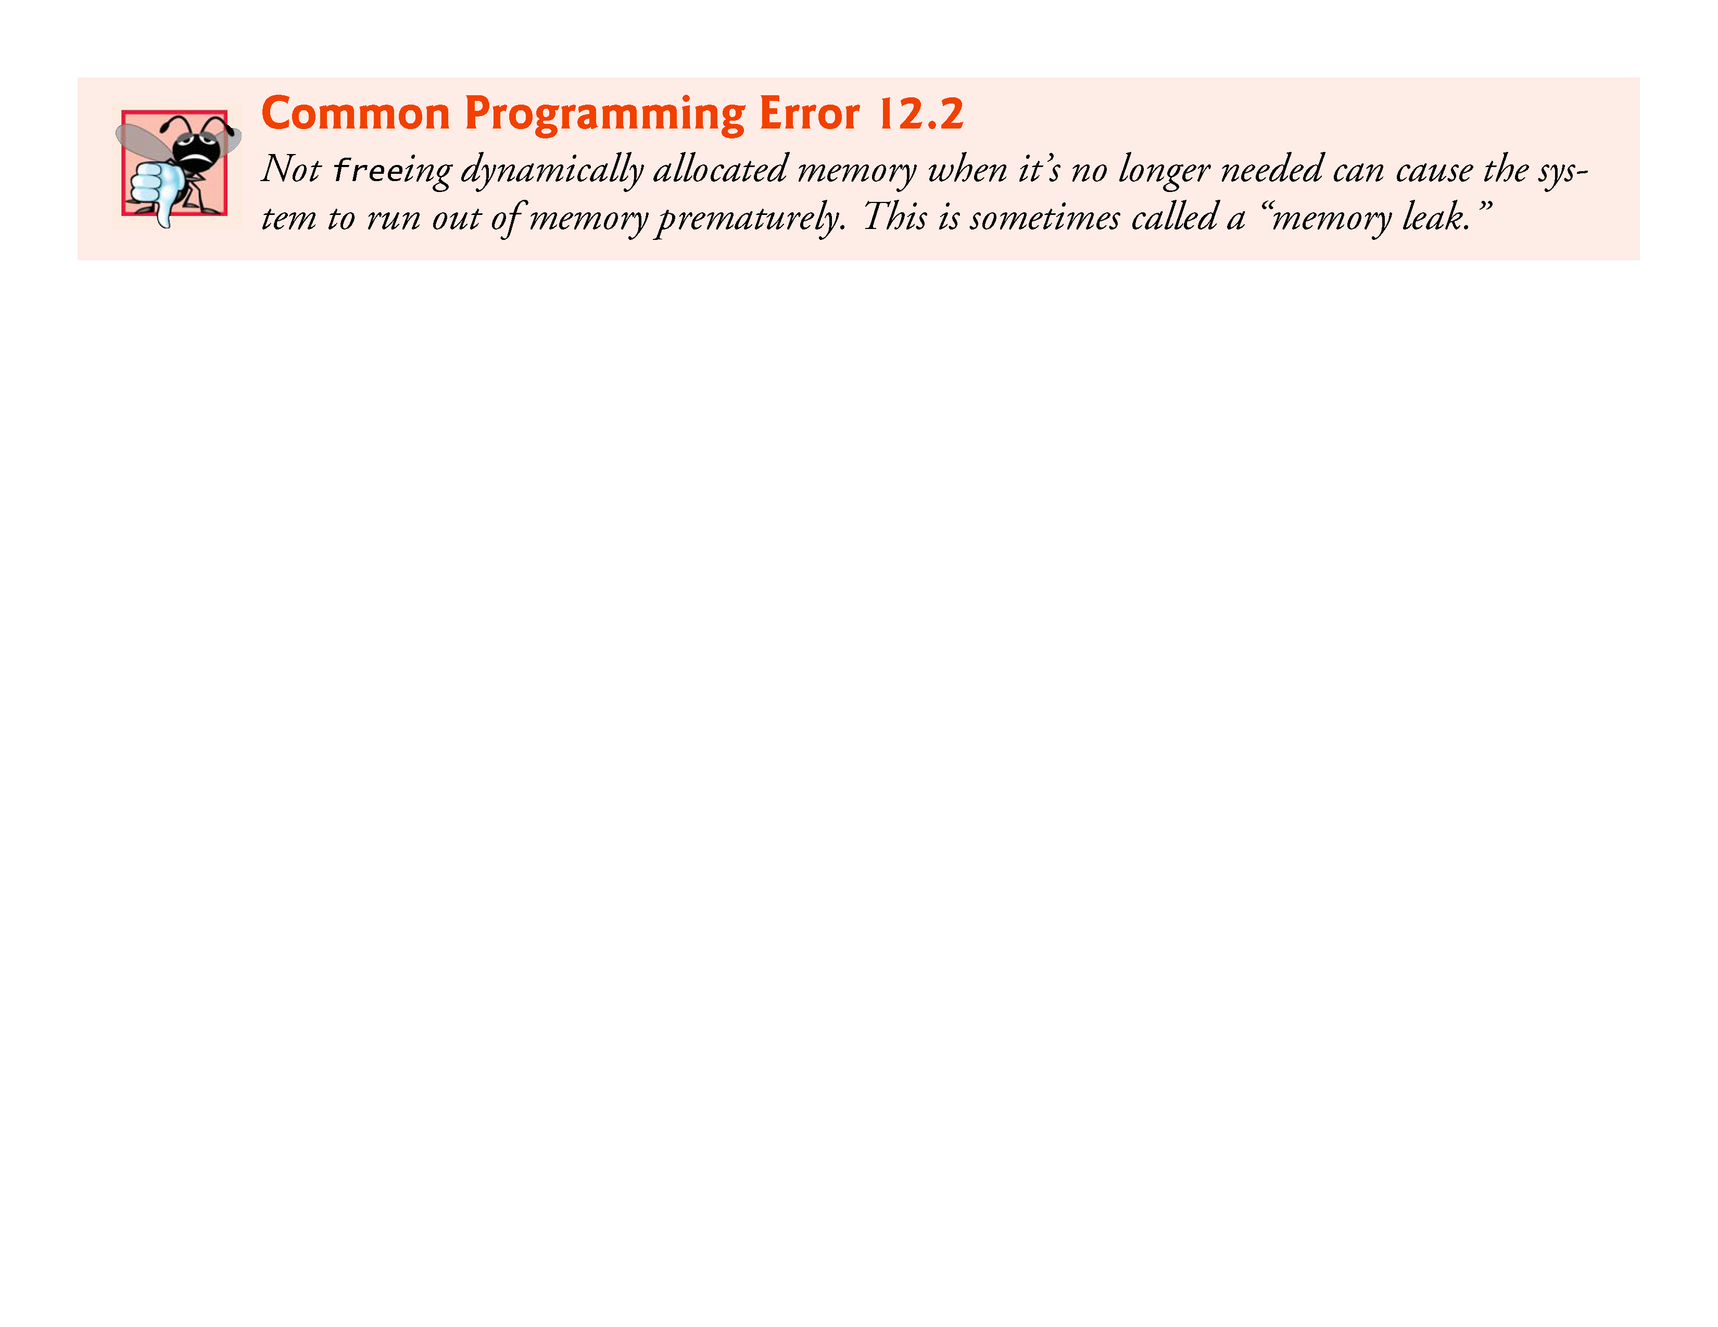
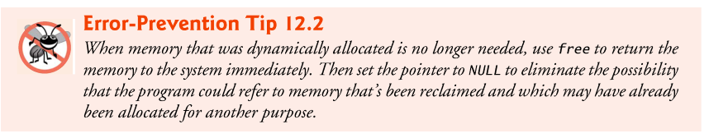



Slide 11
12.4 Linked Lists
Linked List
  a linear collection of self-referential structures, called nodes,
  connected by pointer links—hence, the term “linked” list.
  accessed via a pointer to the first node of the list.
  Subsequent nodes are accessed via the link pointer member stored in each node.
  Link pointer in the last node of a list is set to NULL to mark the end of the list.

Slide 12
12.4 Linked Lists (Cont.)
Data is stored in a linked list dynamically—each node is created as necessary.
Lists of data can be stored in arrays, but linked lists provide several advantages.
A linked list is appropriate when the number of data elements is unpredictable.
Linked lists are dynamic, so the length of a list can increase or decrease as necessary.
Linked lists can be maintained in sorted order by inserting each new element at the proper point in the list.

Slide 13
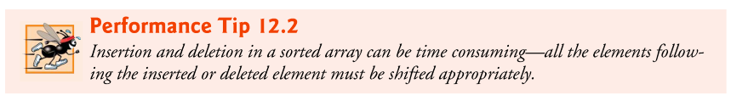
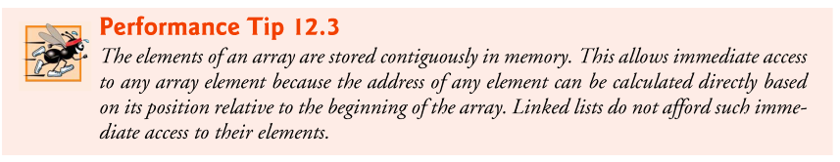

Slide 14
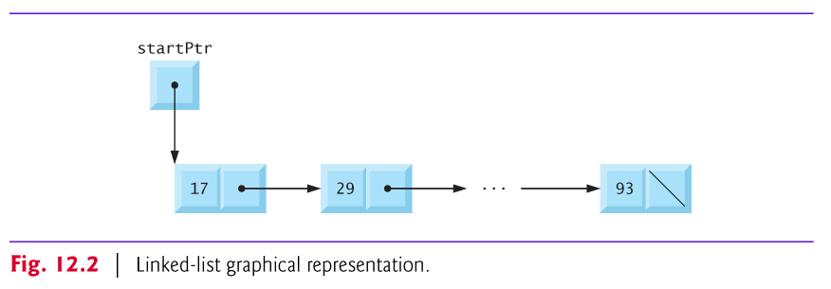
12.4 Linked Lists (Cont.)
Linked-list nodes are normally not stored contiguously in memory.
Logically, however, the nodes of a linked list appear to be contiguous.
Figure 12.2 illustrates a linked list with several nodes.

Slide 15
Example
struct node {
int data;
struct node* next;
};
struct node* BuildOneTwoThree() {
struct node* head = NULL;
struct node* second = NULL;
struct node* third = NULL;
head = malloc(sizeof(struct node));
second = malloc(sizeof(struct node));
third = malloc(sizeof(struct node));
head->data = 1;
head->next = second;
second->data = 2;
second->next = third;
third->data = 3;
third->next = NULL;
// At this point, the linked list referenced by "head"
// matches the list in the drawing.
return head;
}

Slide 16
12.4 Linked Lists (Cont.)
Example:
  Figure 12.3 (output shown in Fig. 12.4) manipulates a list of characters.
  You can
    insert a character in the list in alphabetical order (function insert)
    or
    delete a character from the list (function delete).

Slide 17
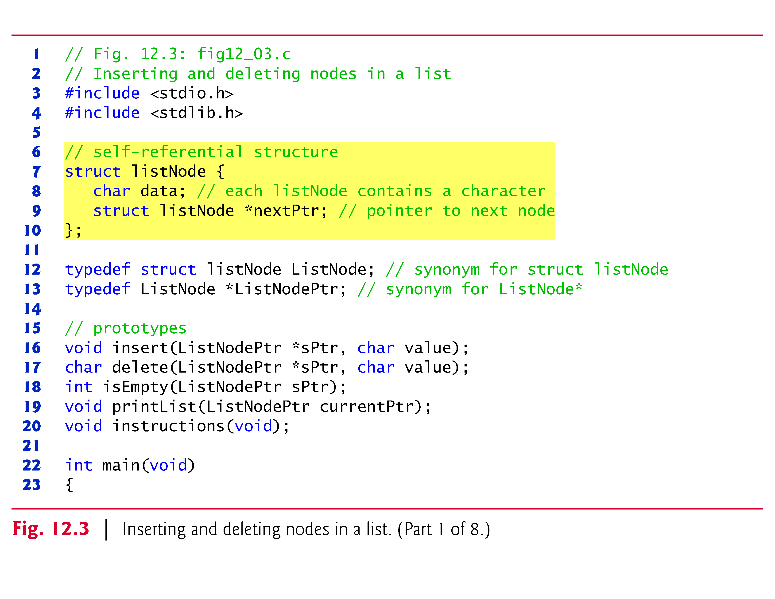
Notes:
- Explain and run C71_fig12_03.c.

Slide 18
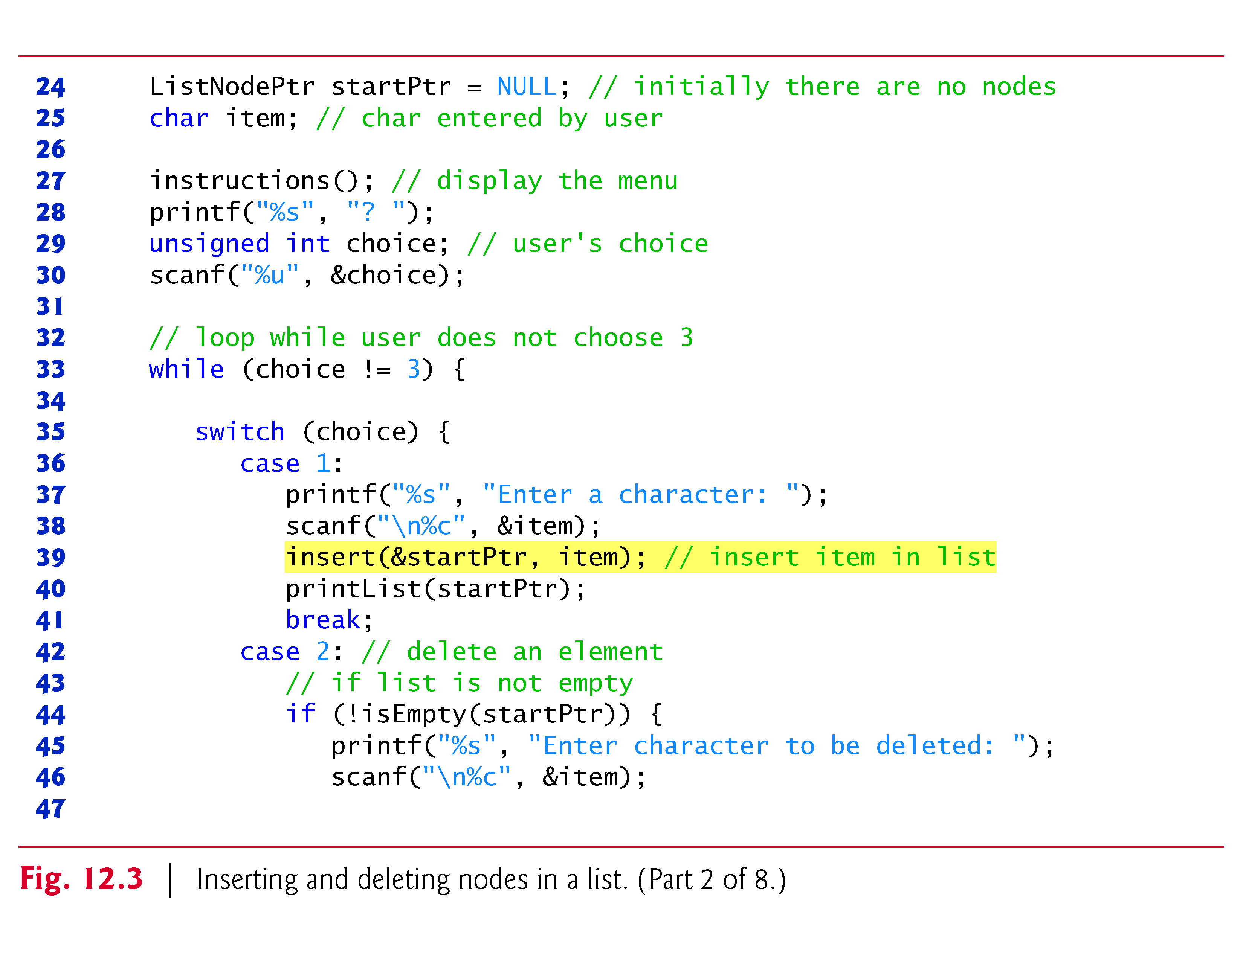

Slide 19
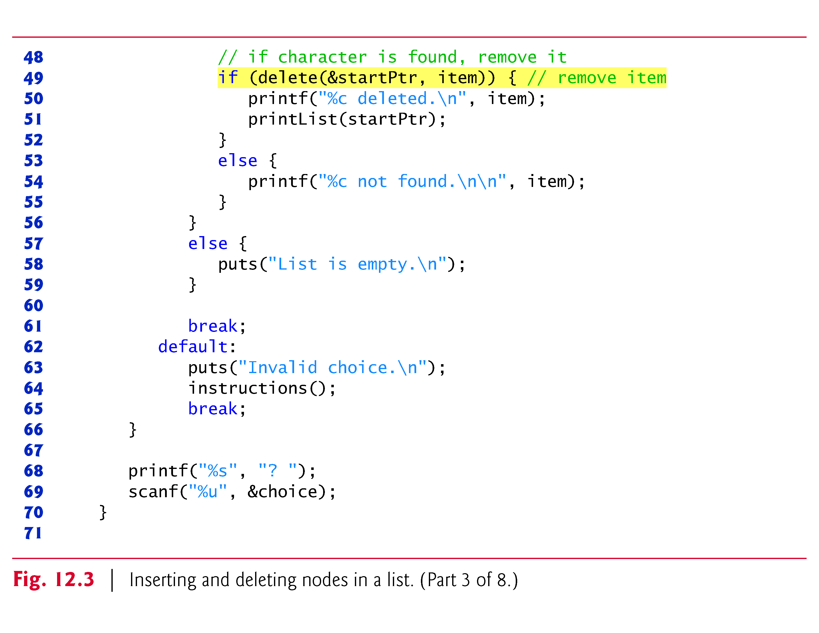

Slide 20
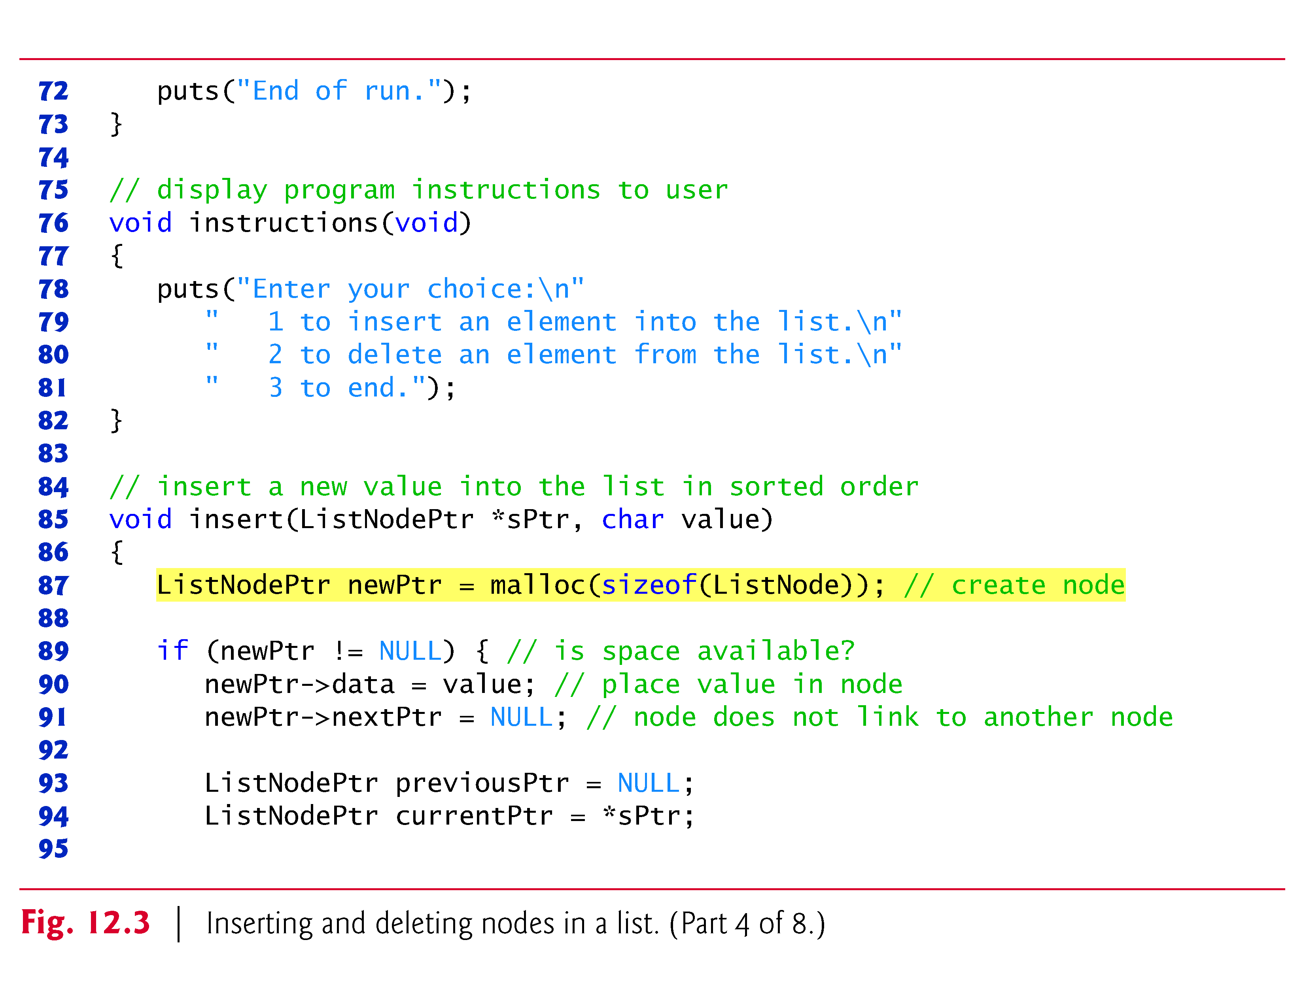

Slide 22
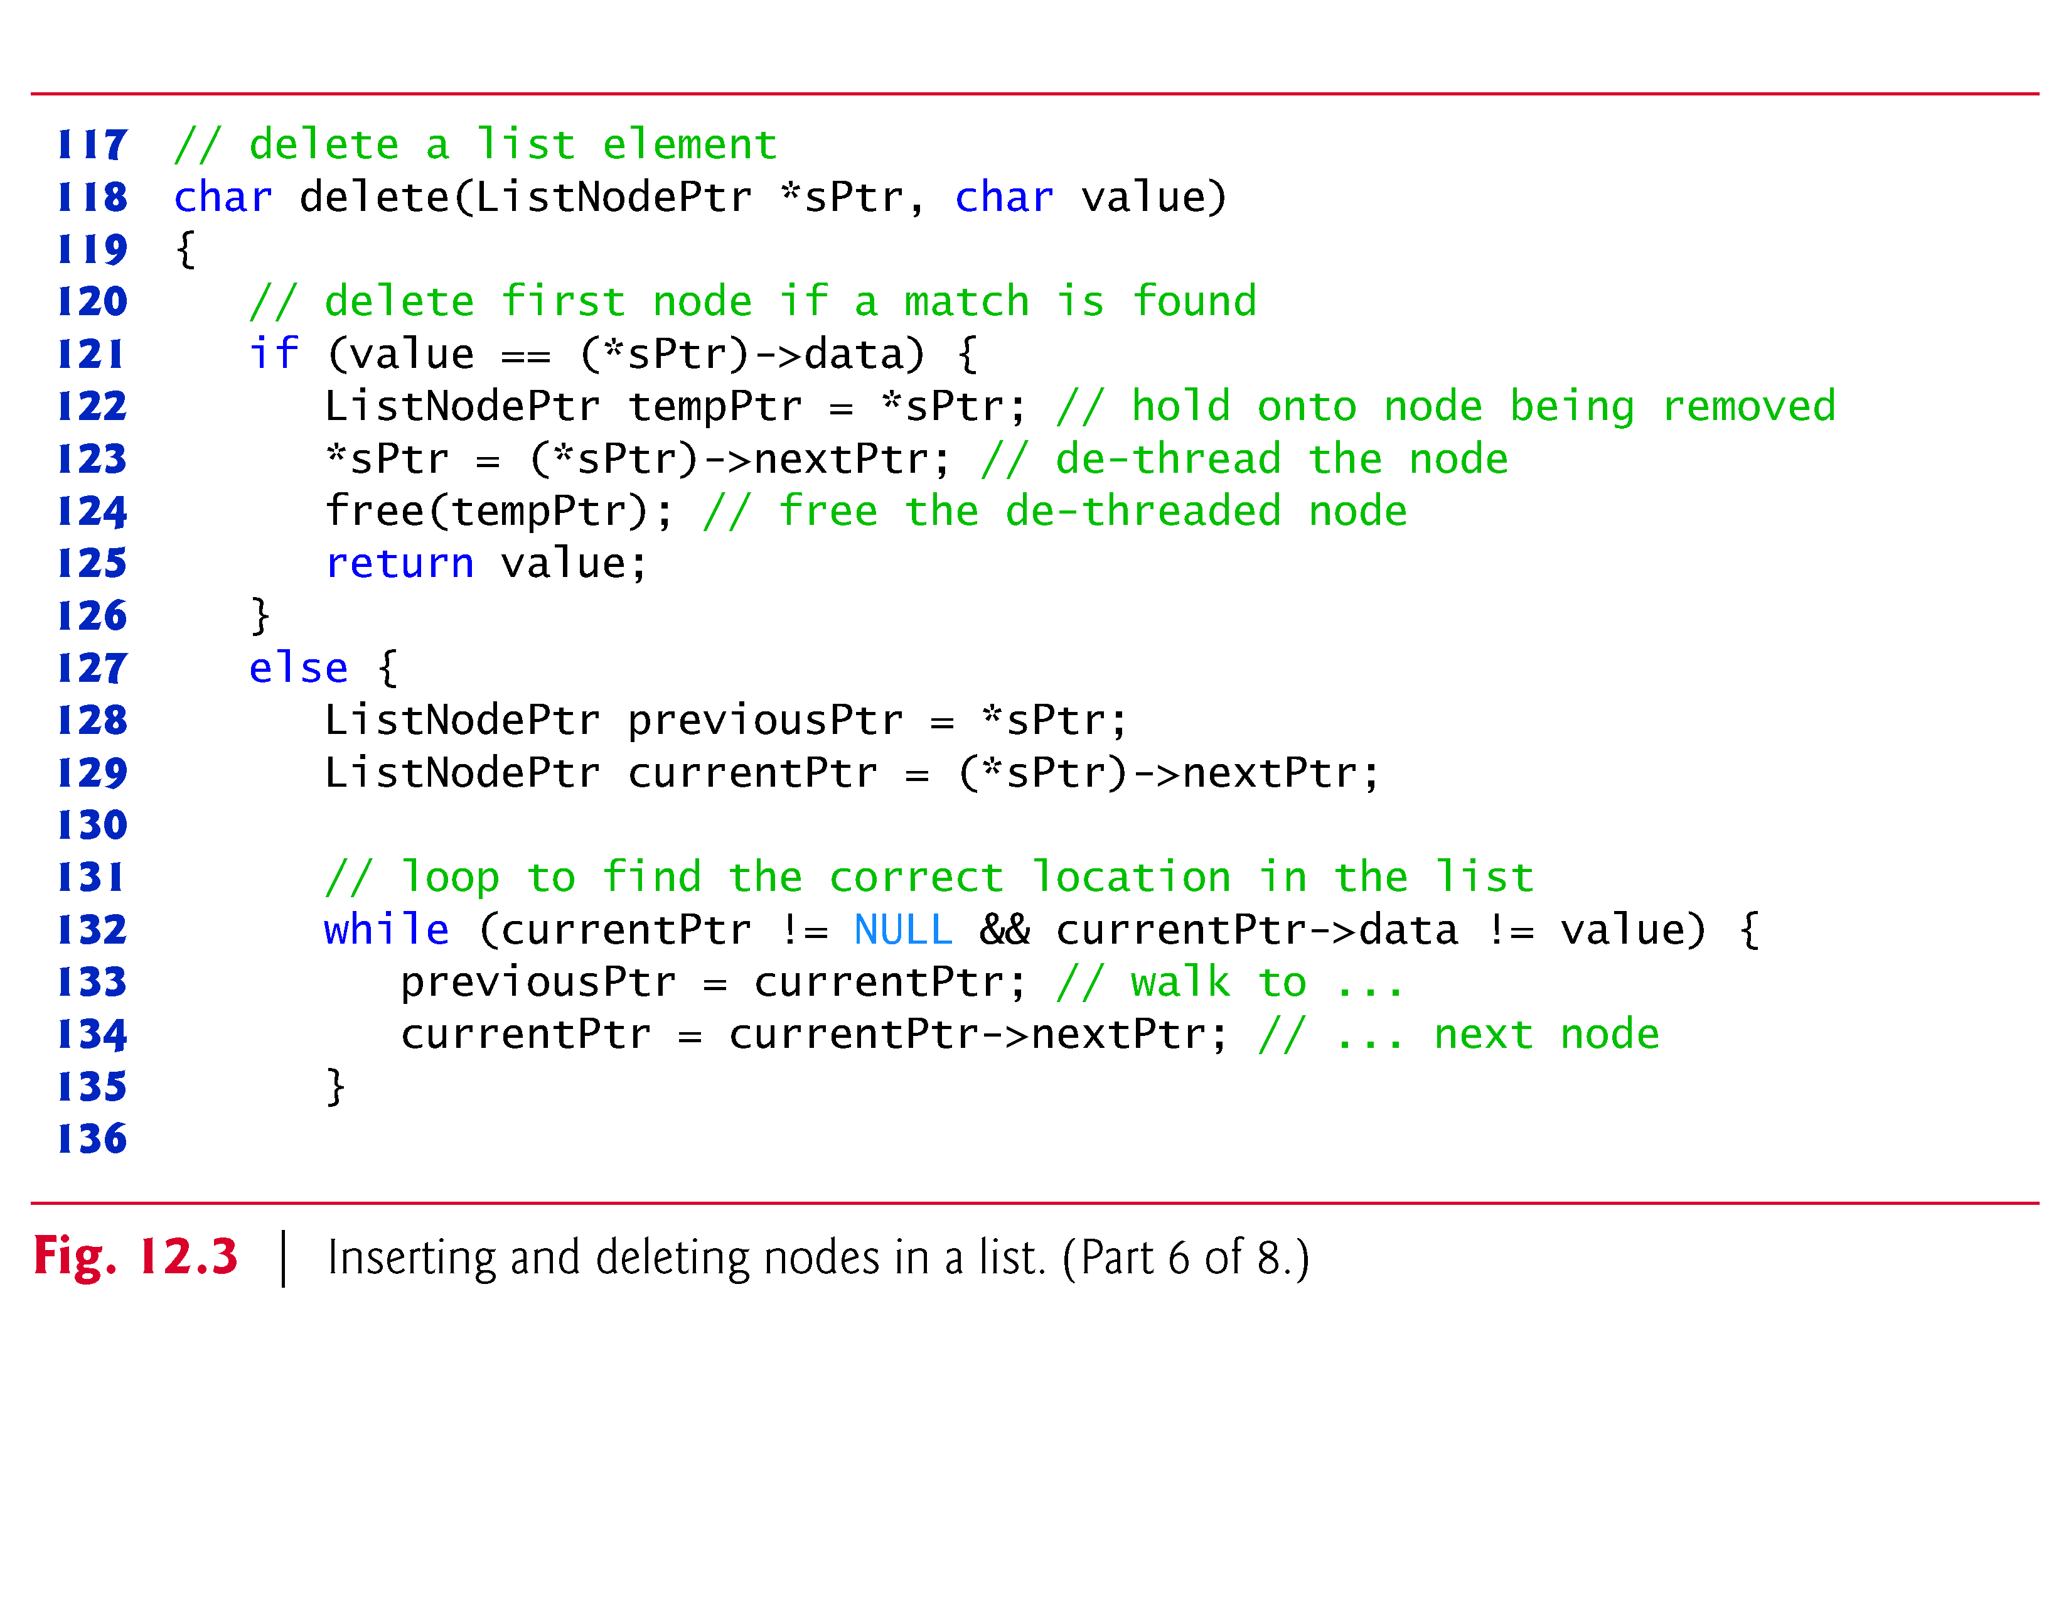

Slide 23
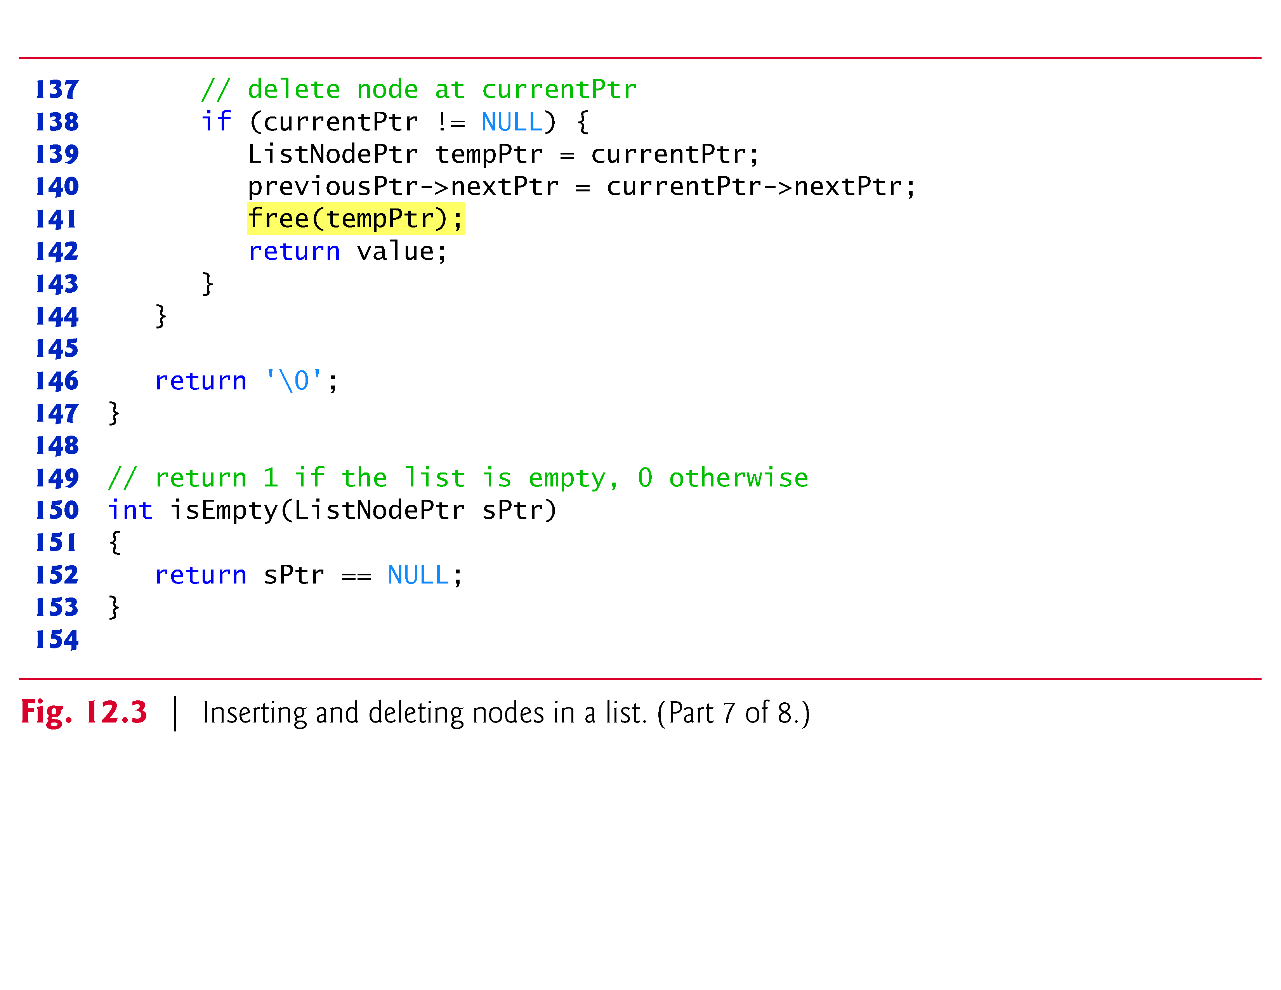

Slide 24
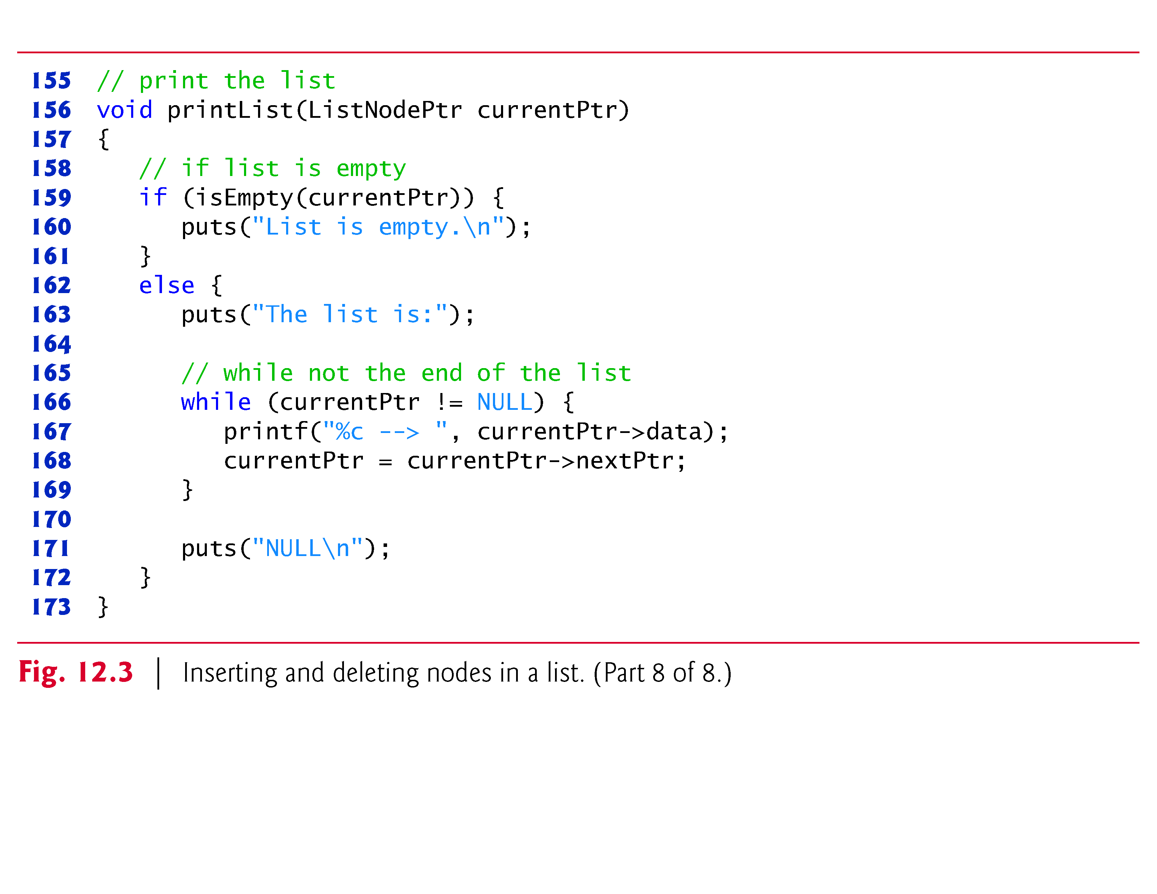

Slide 25
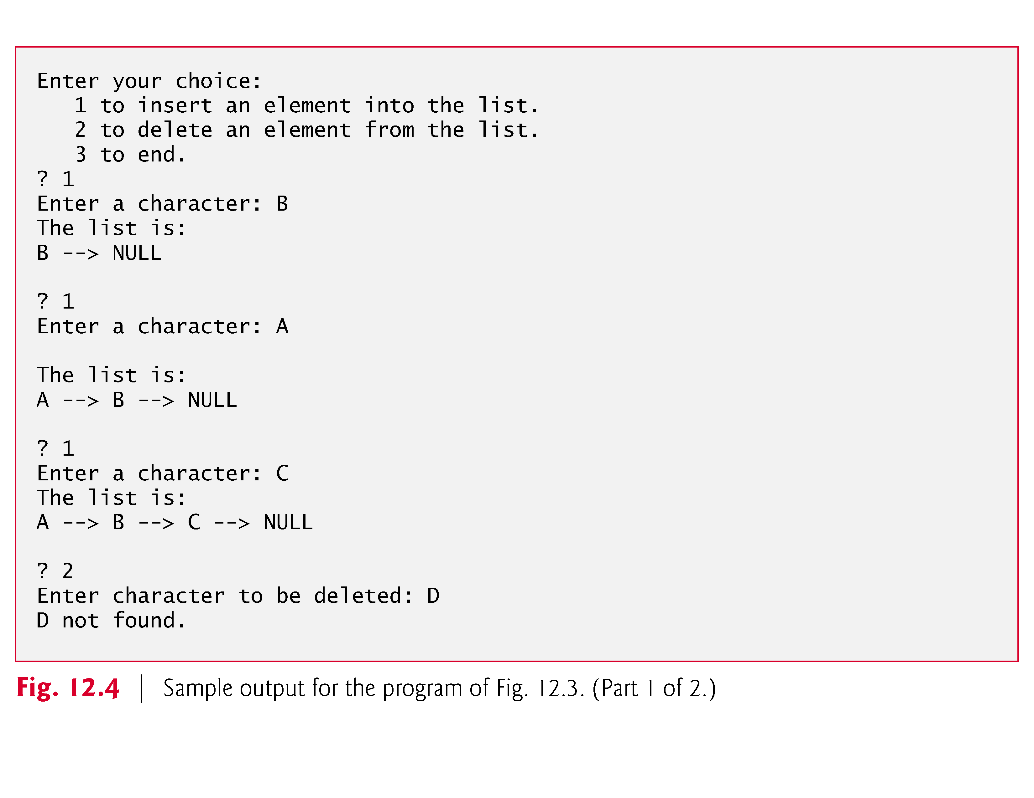

Slide 27
12.4 Linked Lists (Cont.)
Characters are inserted in the list in alphabetical order.
Function insert receives the address of the list and a character to be inserted.
The address of the list is necessary when a value is to be inserted at the start of the list.
Providing the address enables the list (i.e., the pointer to the first node of the list) to be modified via a call by reference.
Because the list itself is a pointer (to its first element), passing its address creates a pointer to a pointer (i.e., double indirection).
This is a complex notion and requires careful programming.

Slide 28
12.4.1 Function insert
Steps for inserting a character in the list (Fig. 12.5):
  Create a node:
    call malloc,
    assign to newPtr the address of the allocated memory,
    assign the character to be inserted to newPtr->data,
    assign NULL to newPtr->nextPtr
  Initialize previousPtr to NULL
  Initialize currentPtr to *sPtr—the pointer to the start of the list.
    These pointers store the locations of the node preceding the insertion point and the node after the insertion point.
  While currentPtr is not NULL and the value to be inserted is greater than currentPtr->data,
    assign currentPtr to previousPtr
    advance currentPtr to the next node in the list
    This locates the insertion point for the value.

Slide 29
12.4.1 Function insert (Cont.)
If previousPtr is NULL,
  insert the new node as the first node in the list.
  Assign *sPtr to newPtr->nextPtr (the new node link points to the former first node)
  assign newPtr to *sPtr (*sPtr points to the new node).
Otherwise, if previousPtr is not NULL,
  the new node is inserted in place.
  Assign newPtr to previousPtr->nextPtr (the previous node points to the new node)
  assign currentPtr to newPtr->nextPtr (the new node link points to the current node).

Slide 30
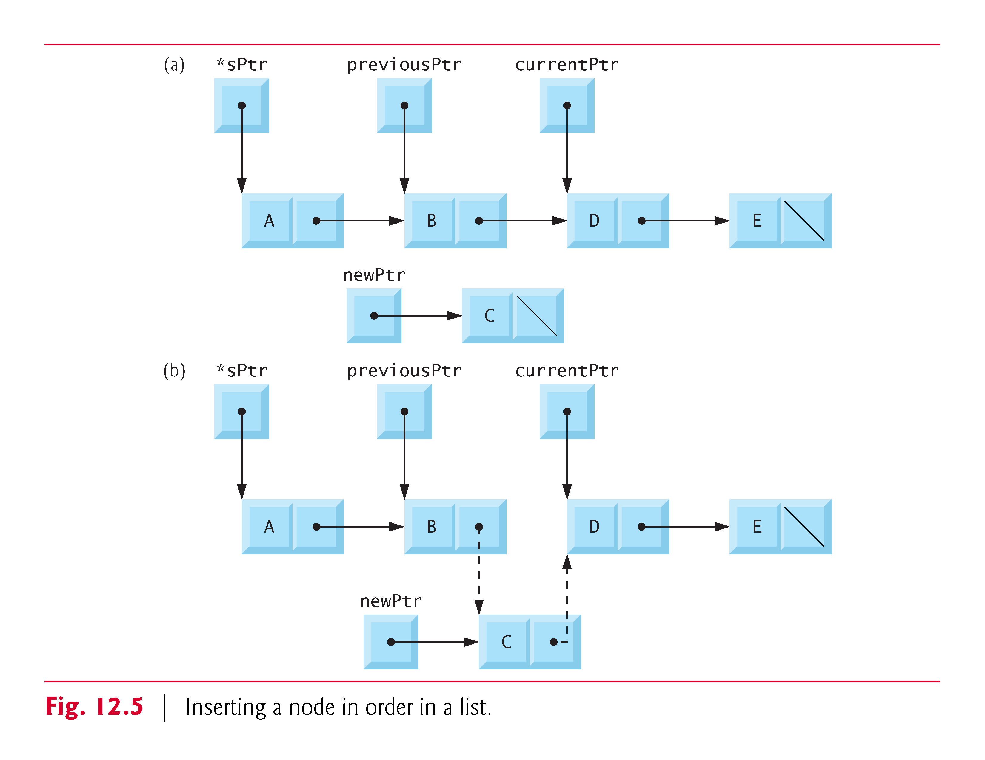

Slide 31
12.4.2 Function delete
Function delete receives the address of the pointer to the start of the list and a character to be deleted.
Steps for deleting a character from the list:
  If the character to be deleted matches the character in the first node of the list,
    assign *sPtr to tempPtr (tempPtr will be used to free the unneeded memory),
    assign (*sPtr)->nextPtr to *sPtr (*sPtr now points to the second node in the list),
    free the memory pointed to by tempPtr,
    return the character that was deleted.
  Otherwise, initialize previousPtr with *sPtr and initialize currentPtr with (*sPtr)->nextPtr to advance the second node.

Slide 32
12.4.2 Function delete (cont.)
Steps for deleting a character from the list:
  While currentPtr is not NULL and the value to be deleted is not equal to currentPtr->data,
    assign currentPtr to previousPtr,
    assign currentPtr->nextPtr to currentPtr.
    This locates the character to be deleted if it’s contained in the list.
  If currentPtr is not NULL,
    assign currentPtr to tempPtr,
    assign currentPtr->nextPtr to previousPtr->nextPtr,
    free the node pointed to by tempPtr, and return the character that was deleted from the list.
  If currentPtr is NULL,
    return the null character ('\0') to signify that the character to be deleted was not found in the list.

Slide 33
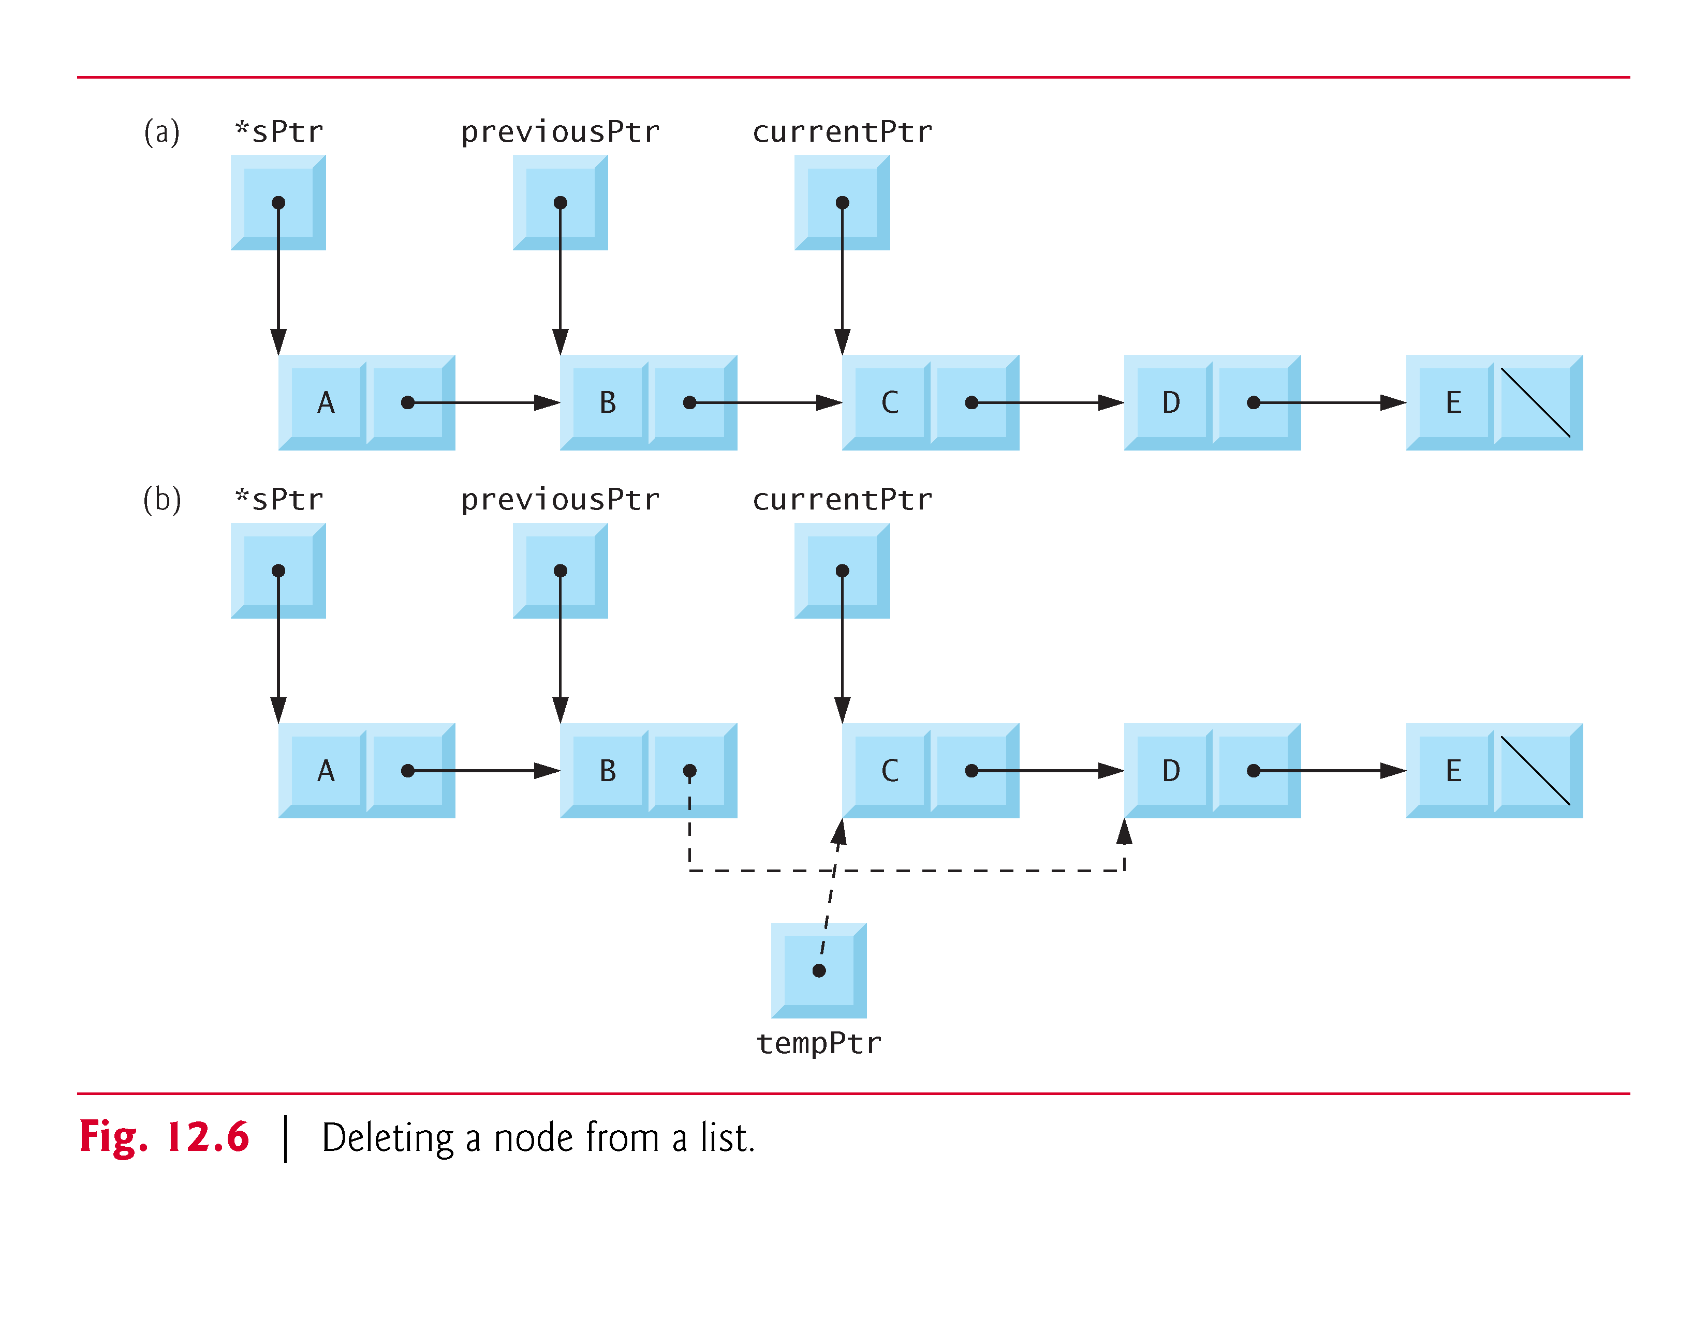

Slide 34
12.4.3 Function printList
Function printList receives a pointer to the start of the list as an argument and refers to the pointer as currentPtr.
The function first determines whether the list is empty; and if so, prints “List is empty." and terminates.
Otherwise, it prints the data in the list
  While currentPtr is not NULL,
    the value of currentPtr->data is printed by the function,
    currentPtr->nextPtr is assigned to currentPtr to advance to the next node.
If the link in the last node of the list is not NULL, the printing algorithm will try to print past the end of the list, and an error will occur.
The printing algorithm is identical for linked lists, stacks and queues.

Slide 35
12.4 Linked Lists (Cont.)
Types of linked lists:
  Singly linked list
    Begins with a pointer to the first node
    Terminates with a null pointer
    Only traversed in one direction
  Circular, singly linked
    Pointer in the last node points back to the first node
  Doubly linked list
    Two “start pointers” – first element and last element
    Each node has a forward pointer and a backward pointer
    Allows traversals both forwards and backwards
  Circular, doubly linked list
    Forward pointer of the last node points to the first node and backward pointer of the first node points to the last node

Slide 36
12.5 Stacks
Stack
  Can be implemented as a constrained version of a linked list.
  New nodes can be added to a stack and removed from a stack only at the top.
  Similar to a pile of dishes.
  Last-in, first-out (LIFO) data structure.
  A stack is referenced via a pointer to the top element of the stack.
  The link member in the last node of the stack is set to NULL to indicate the bottom of the stack.

Slide 37
12.5 Stacks (Cont.)
The difference between stacks and linked lists:
  insertions and deletions may occur anywhere in a linked list,
  but only at the top of a stack.

Slide 38
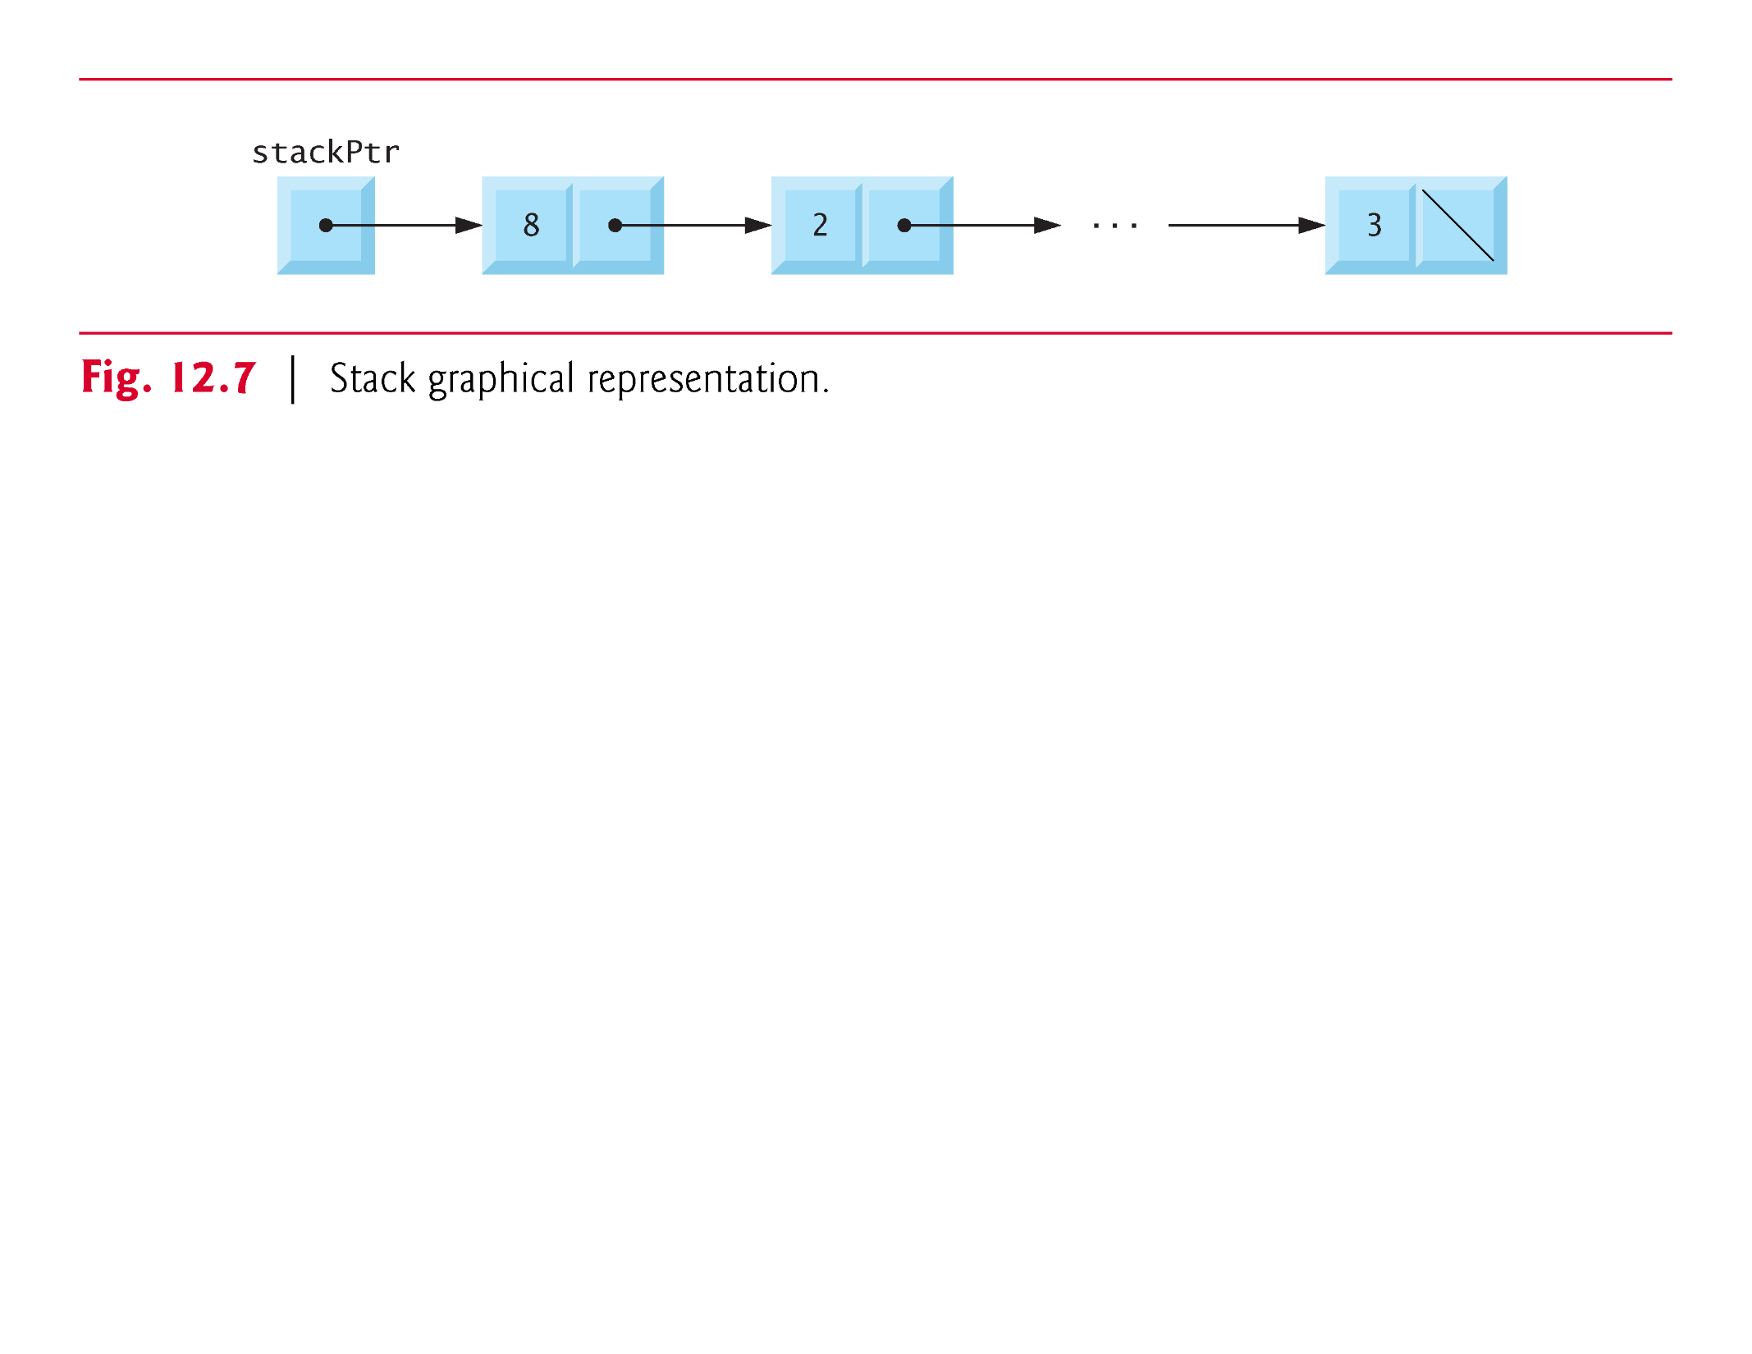

Slide 39
12.5 Stacks (Cont.)
The primary functions used to manipulate a stack are push and pop.
  push
    creates a new node and places it on top of the stack.
  pop
    removes a node from the top of the stack,
    frees the memory that was allocated to the popped node
    returns the popped value.

Slide 40
12.5 Stacks (Cont.)
Example:
  Figure 12.8 (output shown in Fig. 12.9) implements a simple stack of integers.
  The program provides three options:
    1) push a value onto the stack (function push),
    2) pop a value off the stack (function pop)
    3) terminate the program.

Slide 41
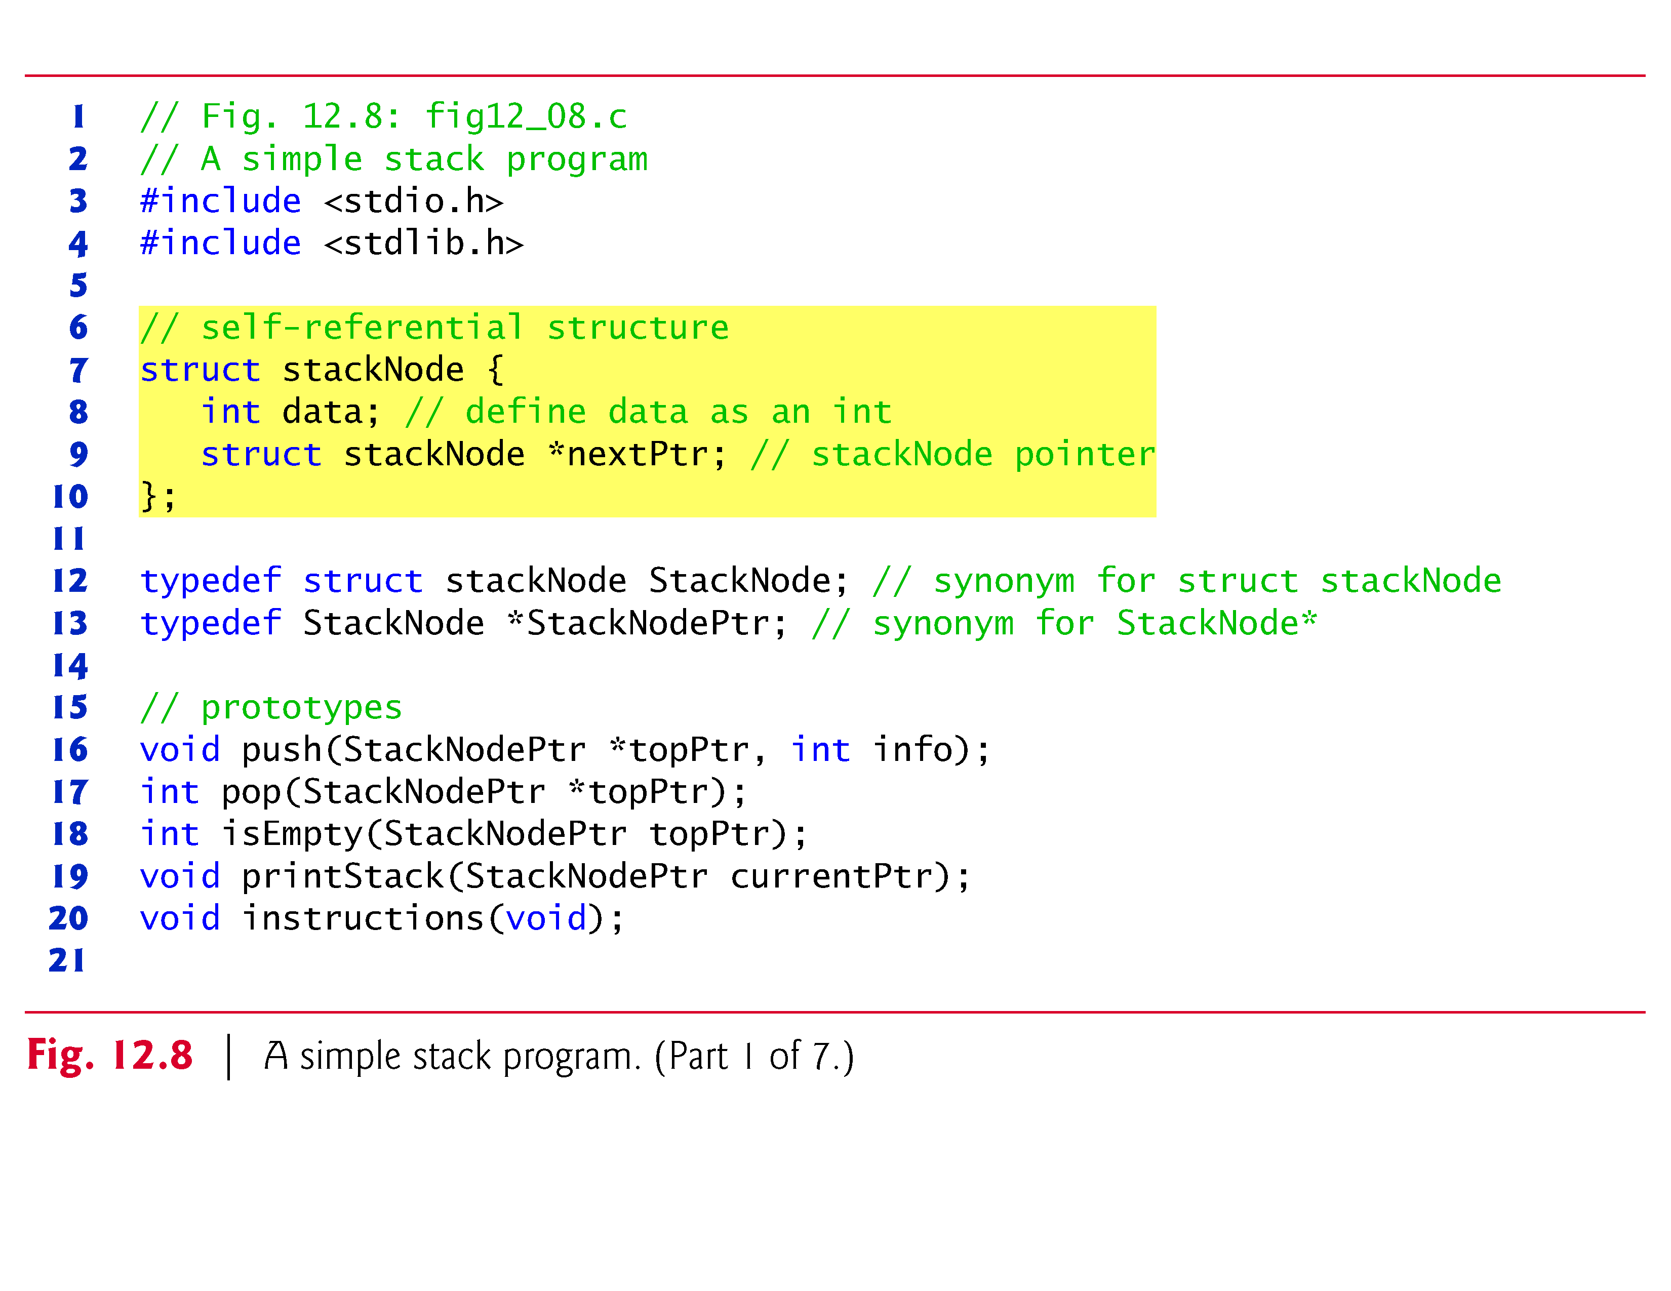

Slide 43
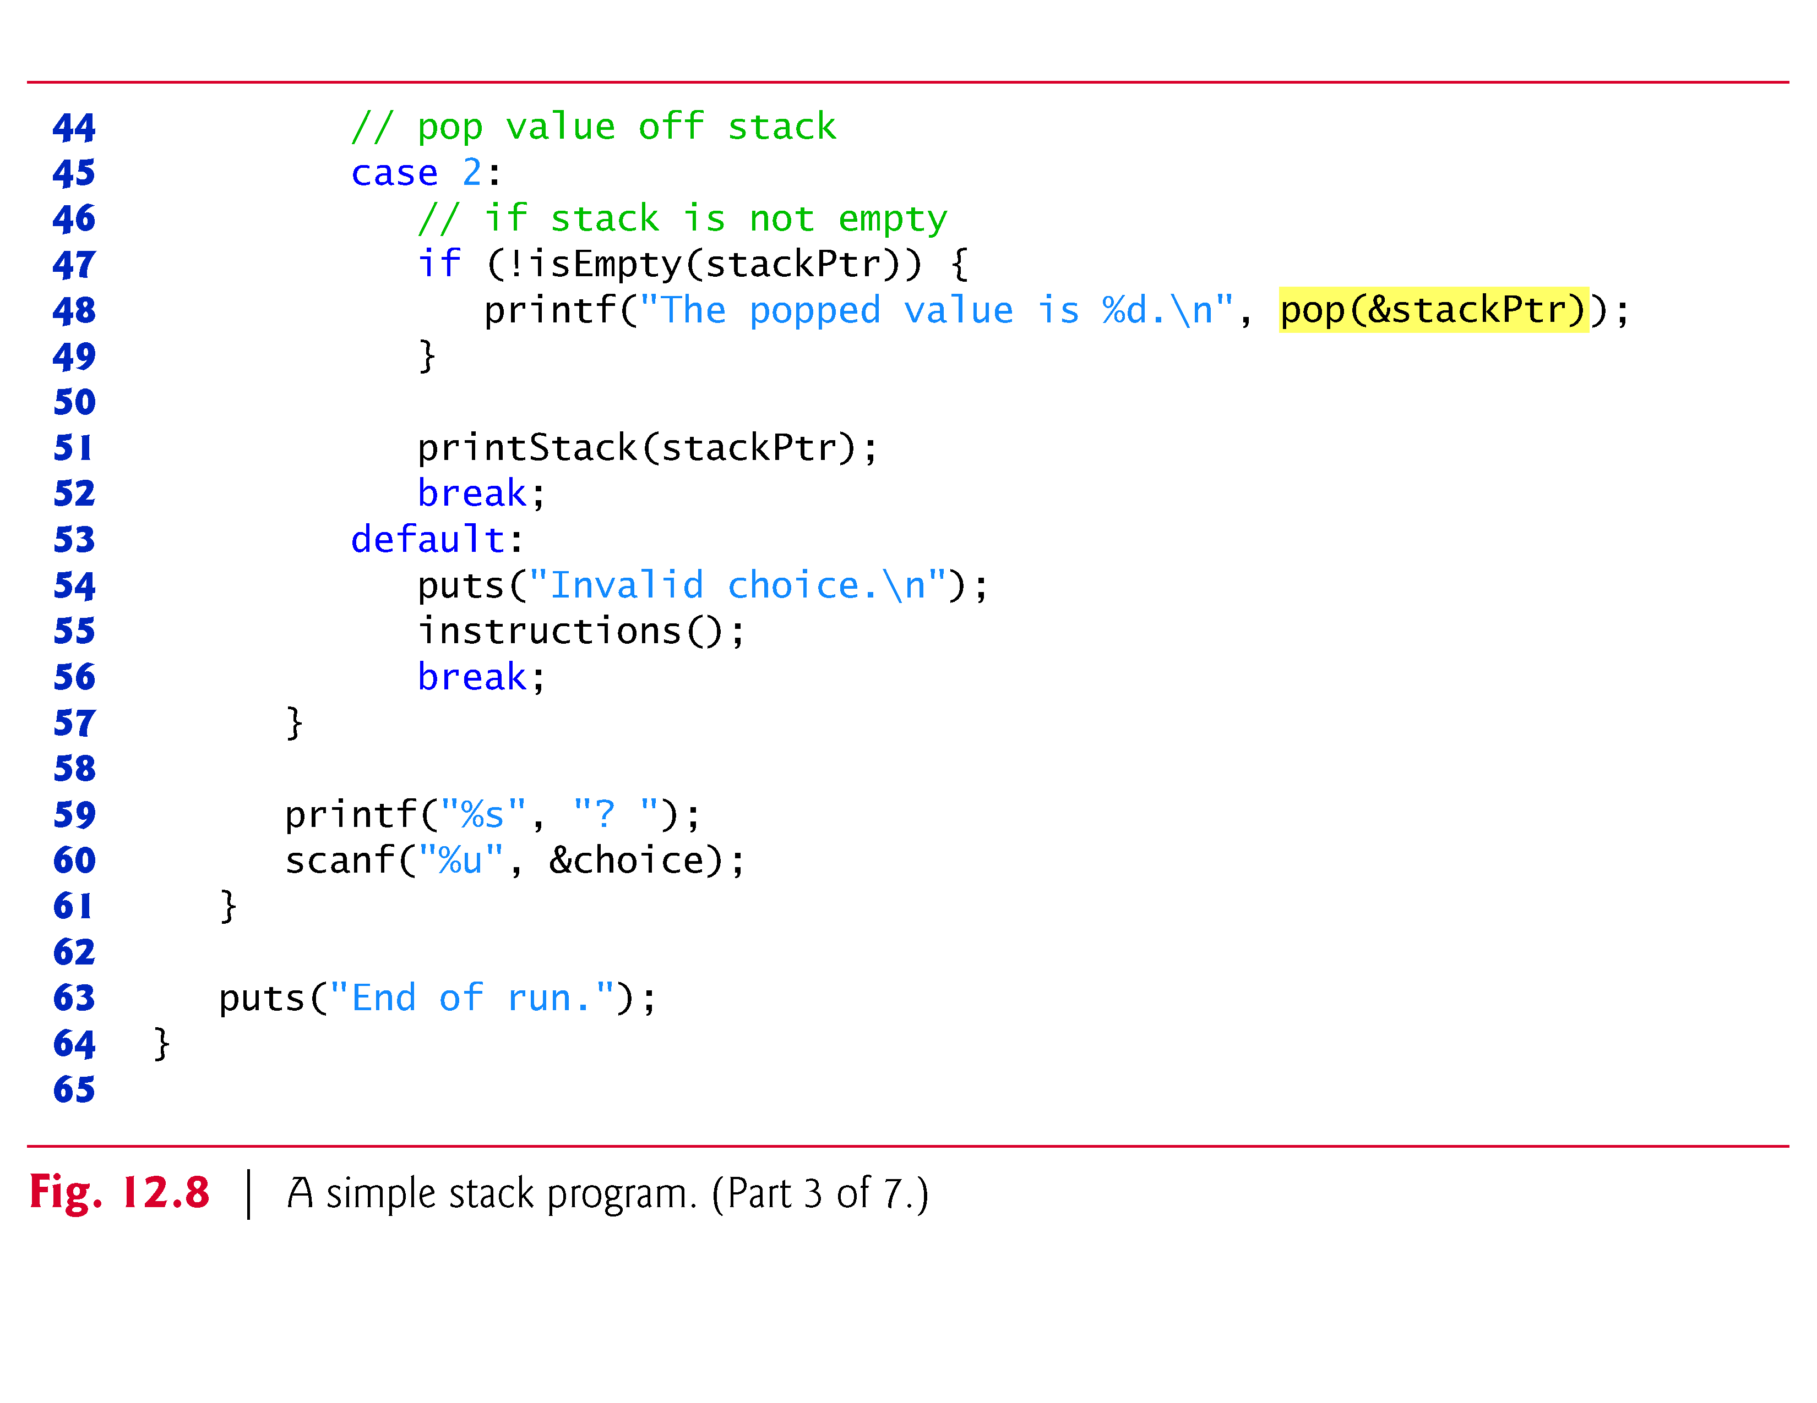

Slide 44
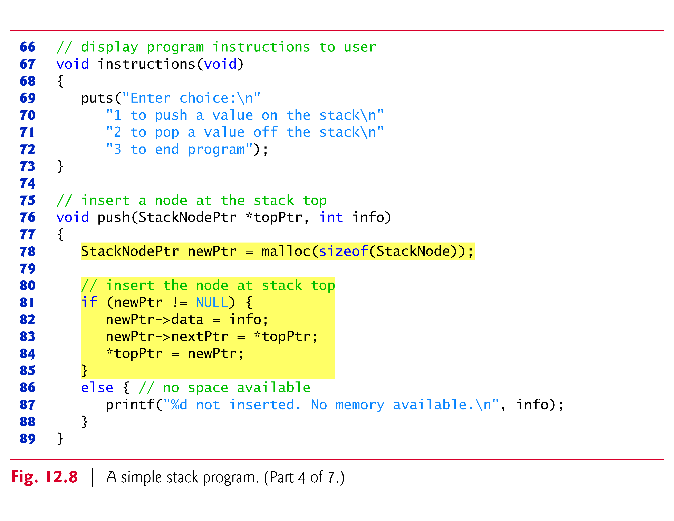

Slide 45
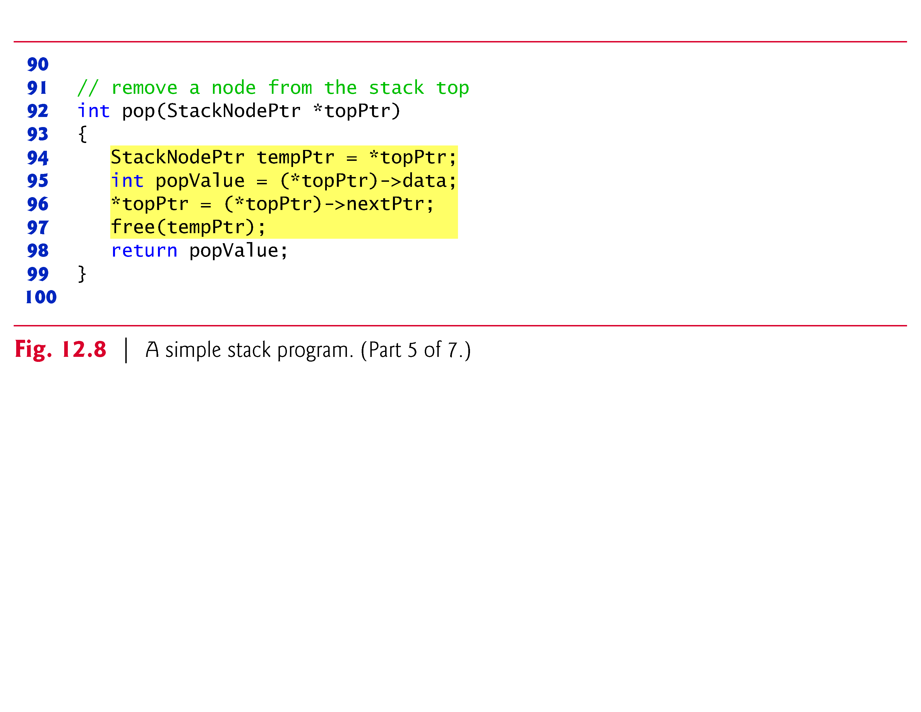

Slide 46
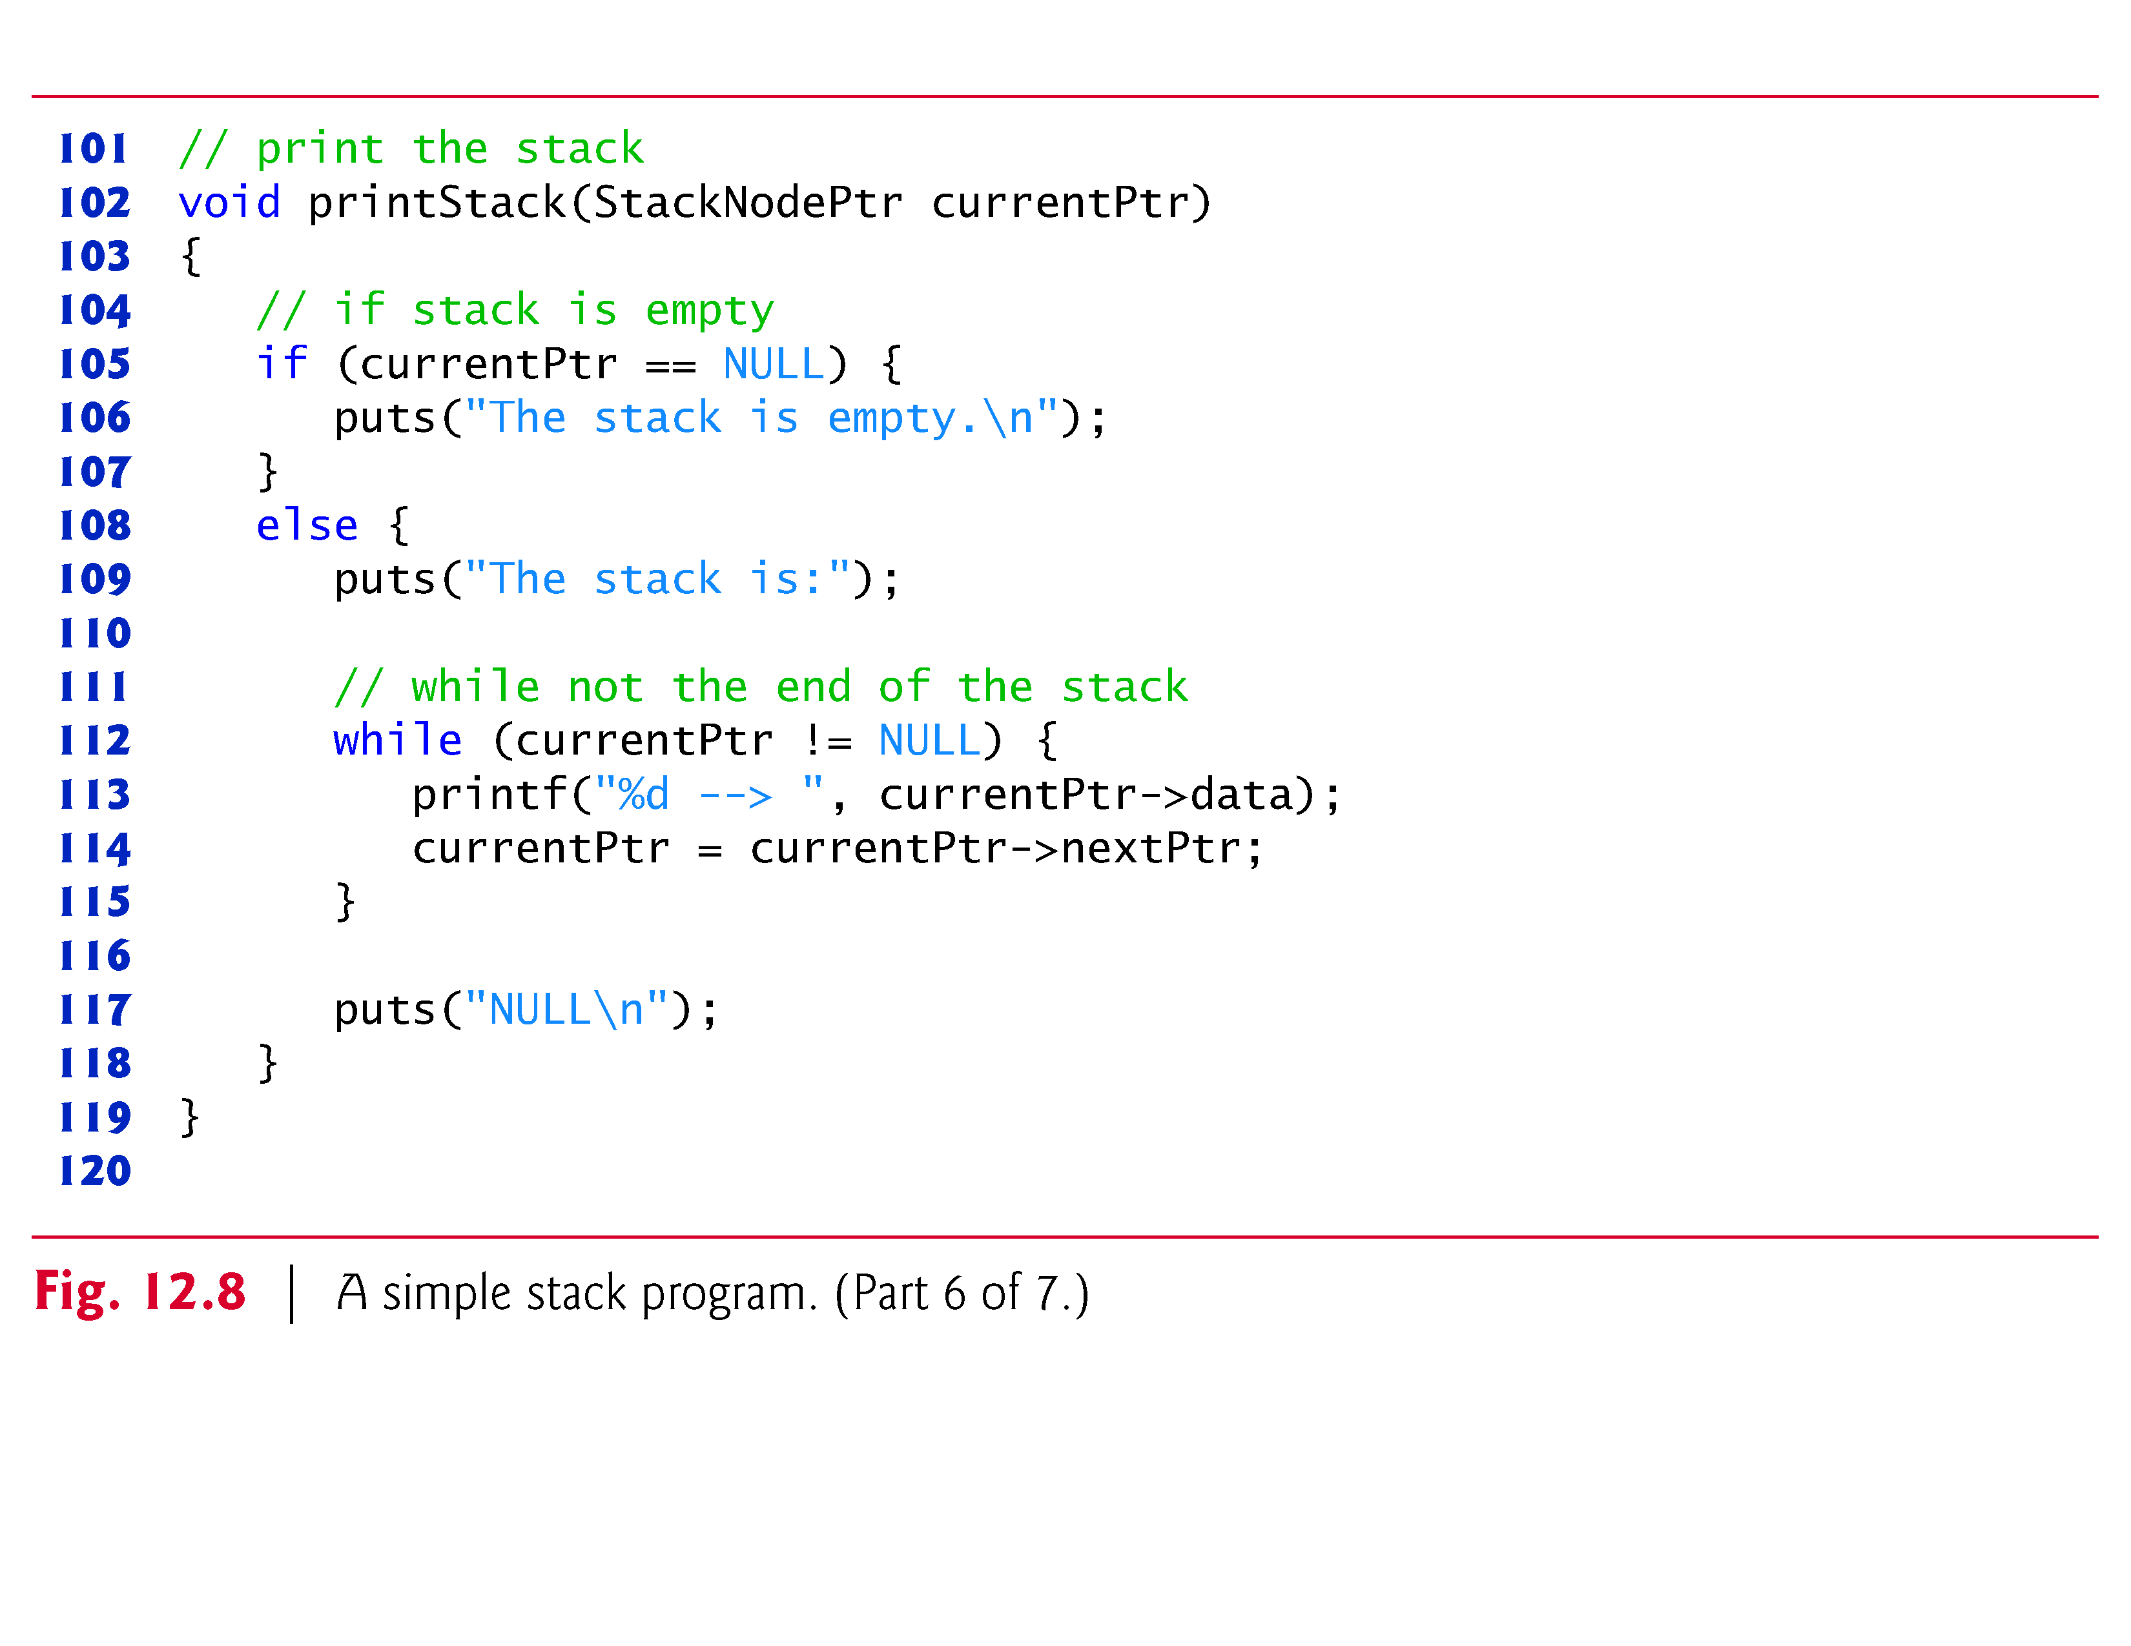

Slide 49
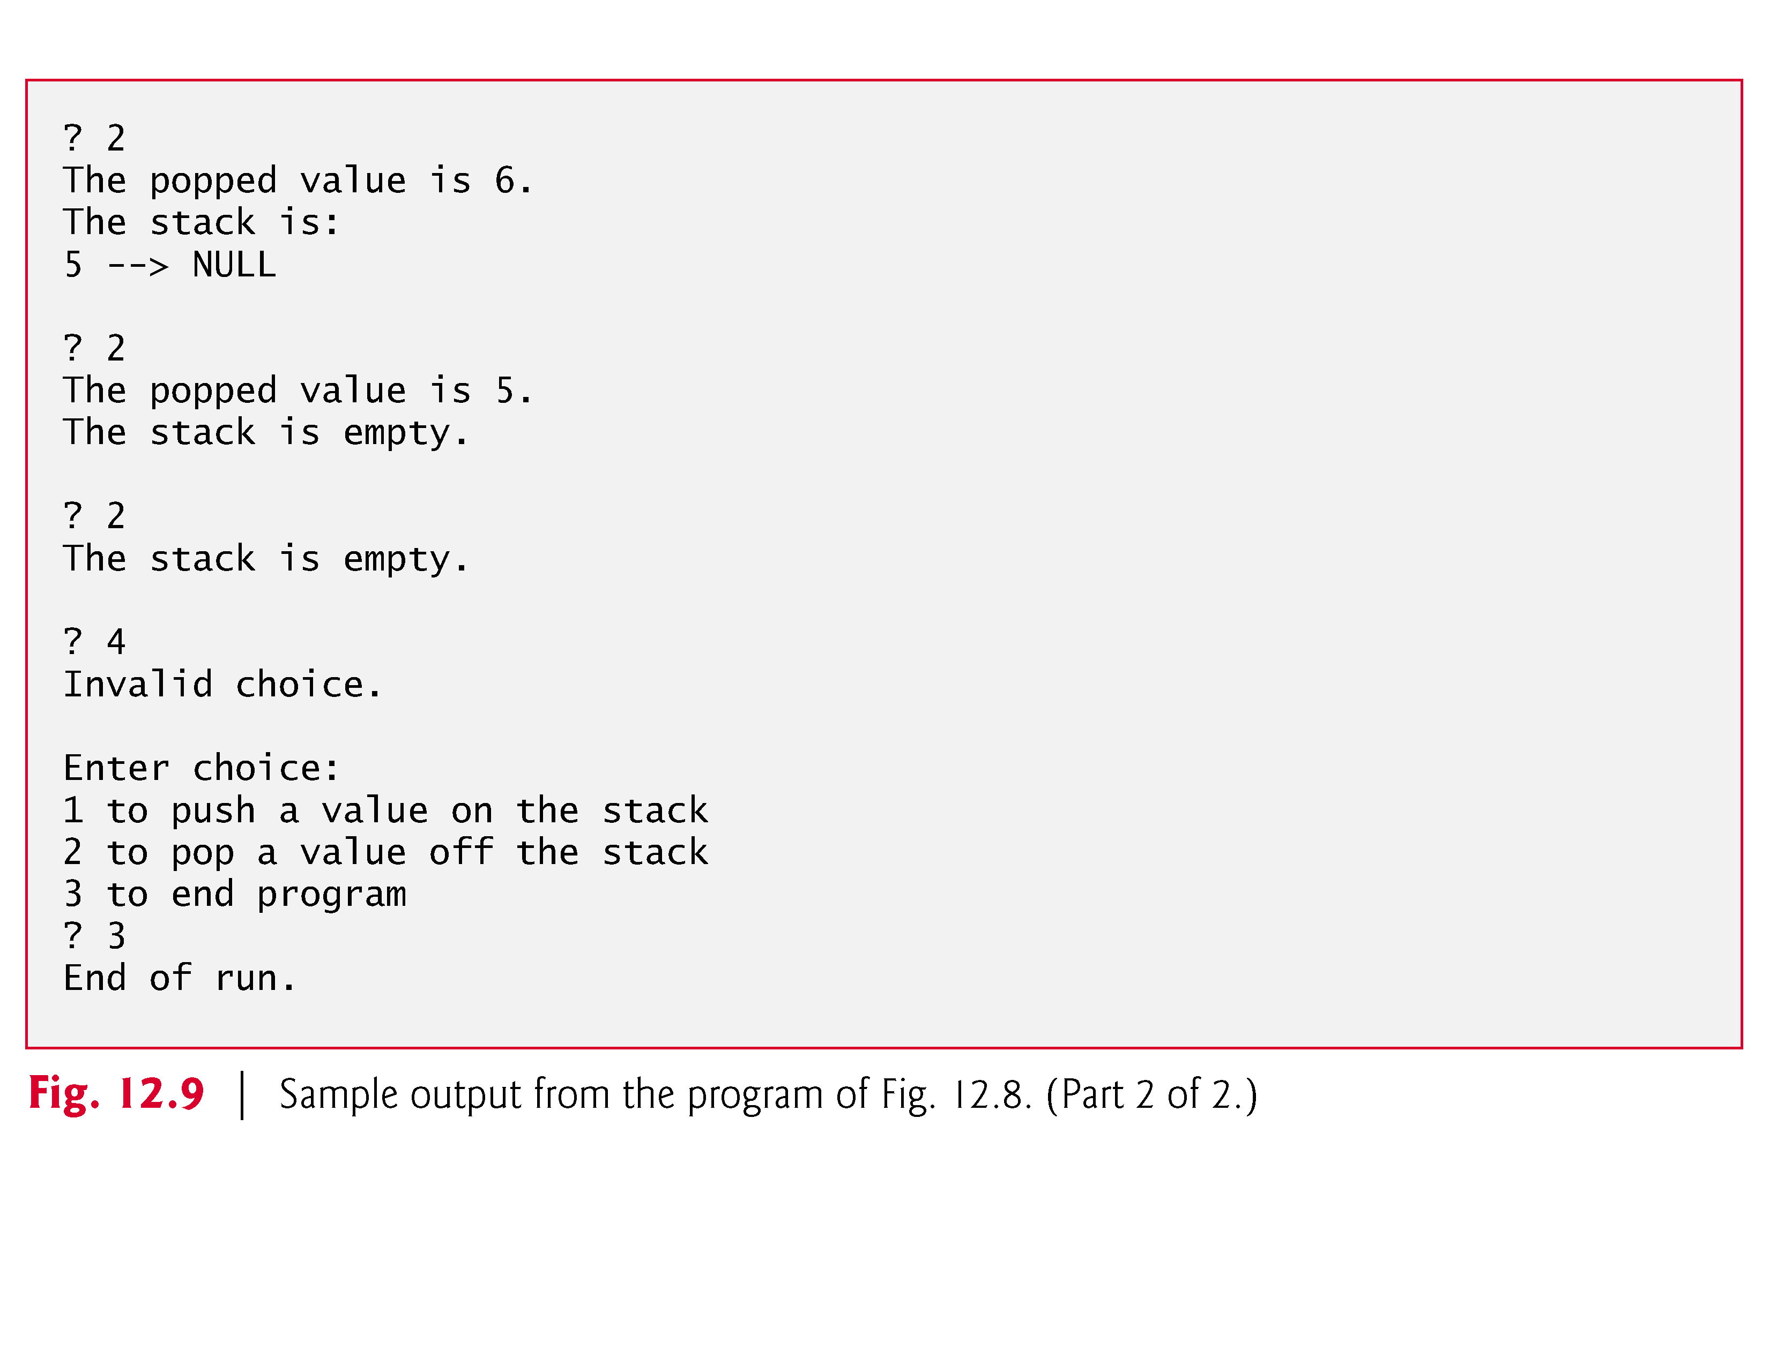

Slide 51
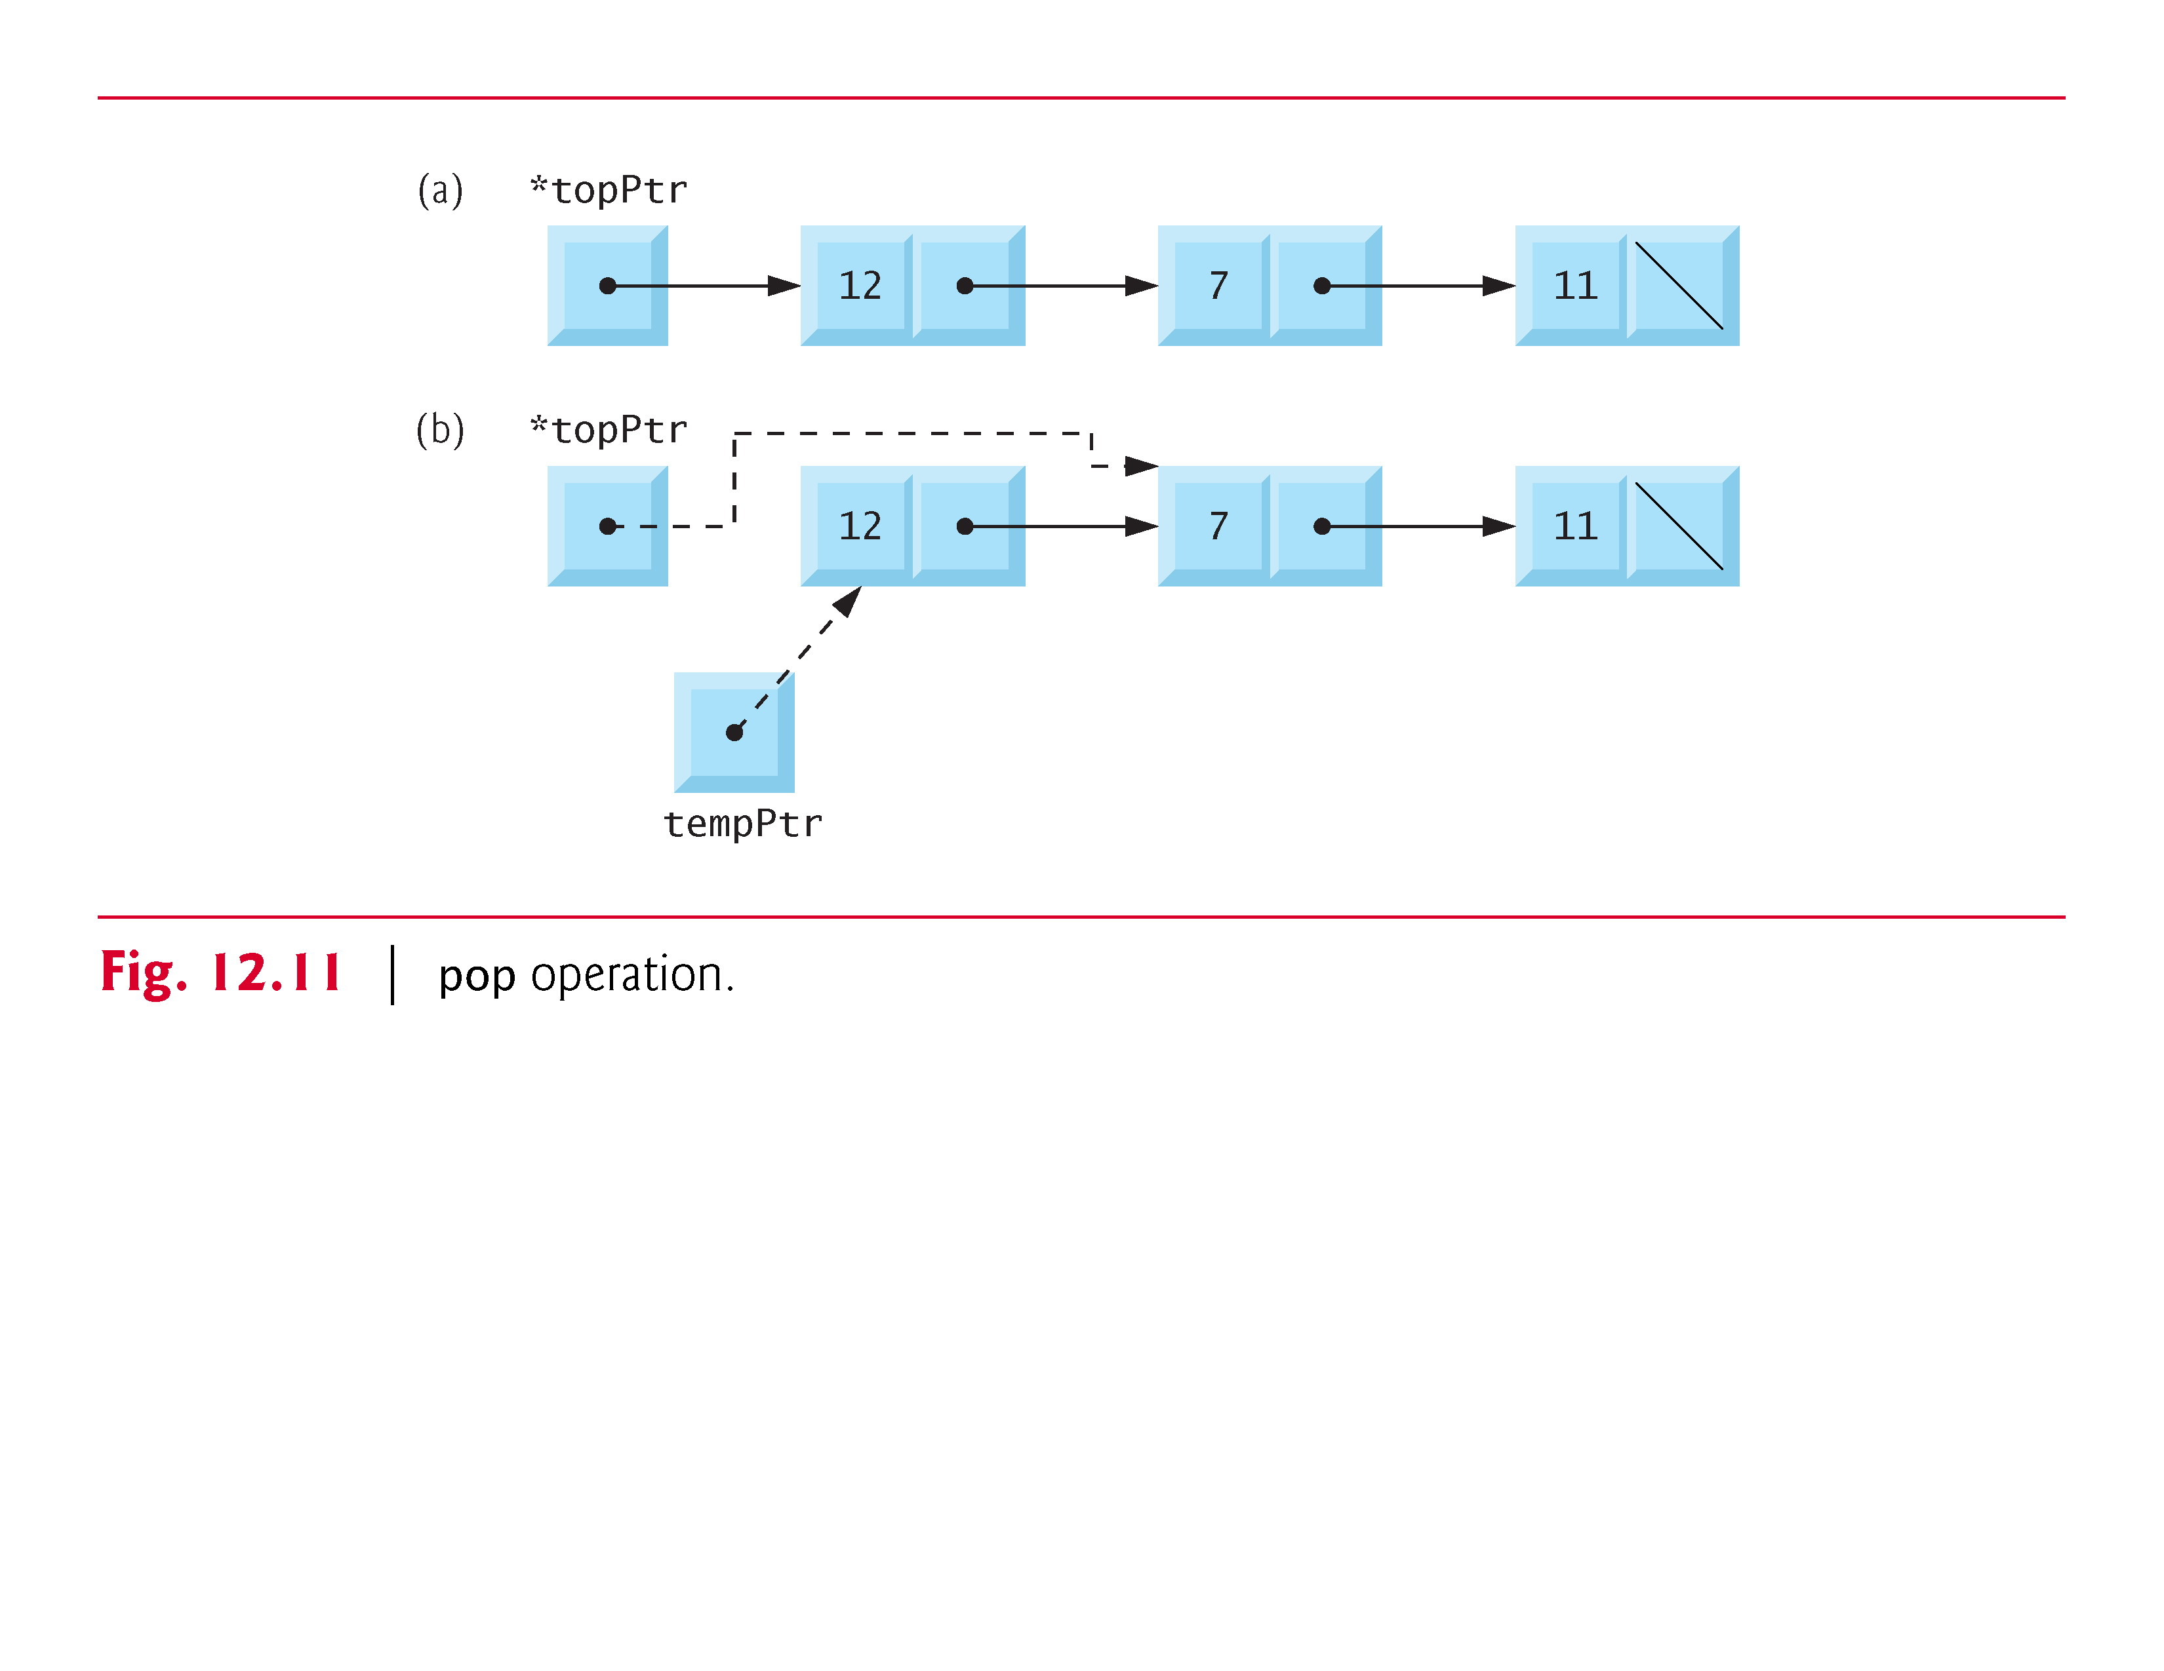

Slide 52
12.5.3 Applications of Stacks
Stacks have many interesting applications.
  Function Call Stack
    If a series of function calls occurs, the successive return values are pushed onto the stack in last-in, first-out order so that each function can return to its caller.
  Stacks are used by compilers in the process of evaluating expressions and generating machine-language code.

Slide 53
12.6 Queues
Queues
  similar to a checkout line in a grocery store
  the first person in line is serviced first, and other customers enter the line only at the end and wait to be serviced.
  nodes are removed only from the head of the queue
  nodes are inserted only at the tail of the queue.
  First-in, first-out (FIFO) data structure.
The insert and remove operations
  enqueue (insert) and dequeue (remove)

Slide 54
12.6 Queues (Cont.)
Queues have many applications in computer systems.
  For computers that have only a single processor, only one user at a time may be serviced.
    Entries for the other users are placed in a queue.
  Queues are also used to support print spooling.
    Many users may be generating outputs to be printed.
    These are spooled to disk where they wait in a queue until the printer becomes available.

Slide 55
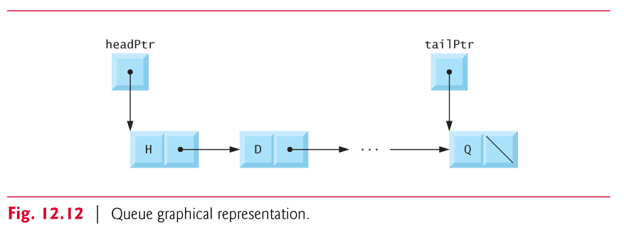
12.6 Queues (Cont.)
Figure 12.12 illustrates a queue with several nodes.
Note the pointers to the head of the queue and the tail of the queue.

Slide 56
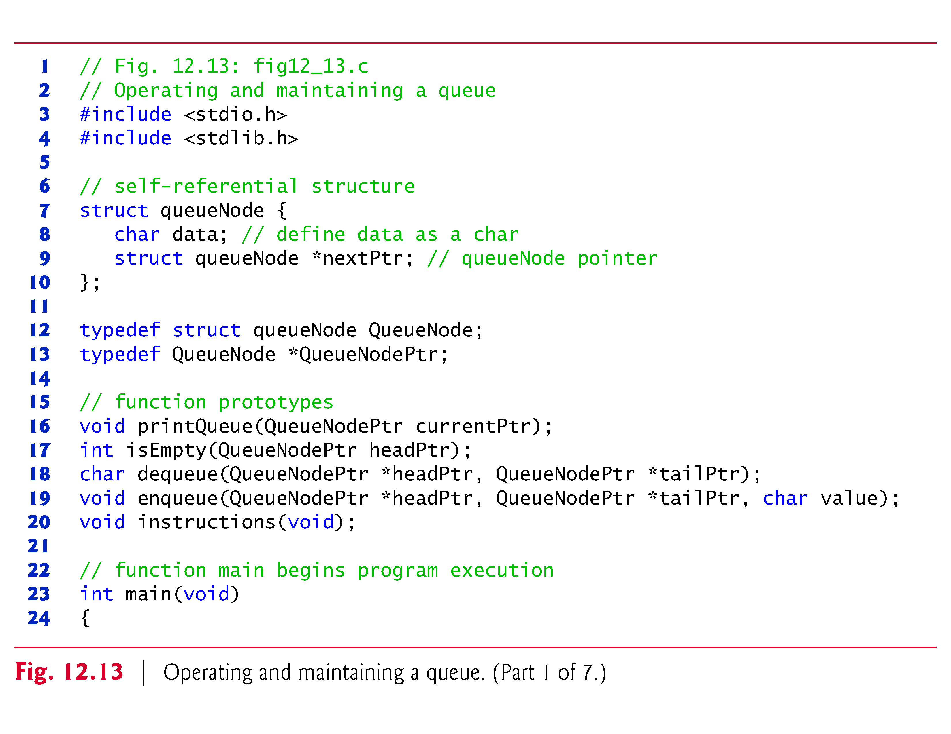

Slide 57
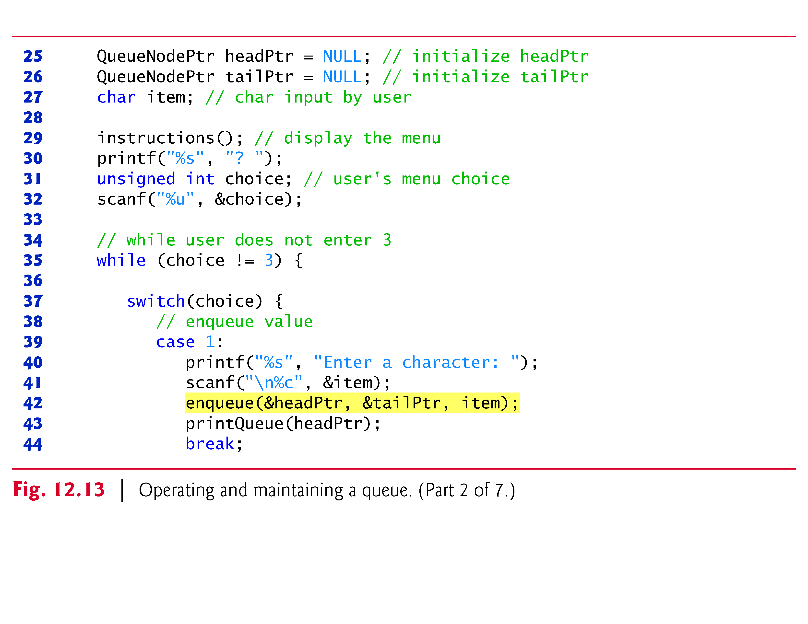

Slide 59
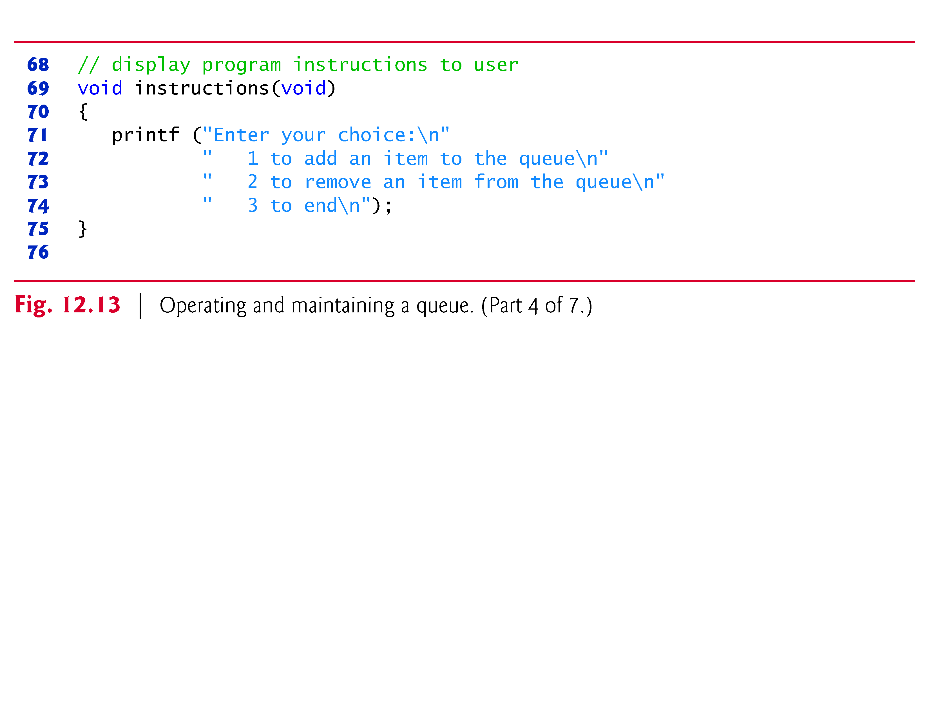

Slide 61
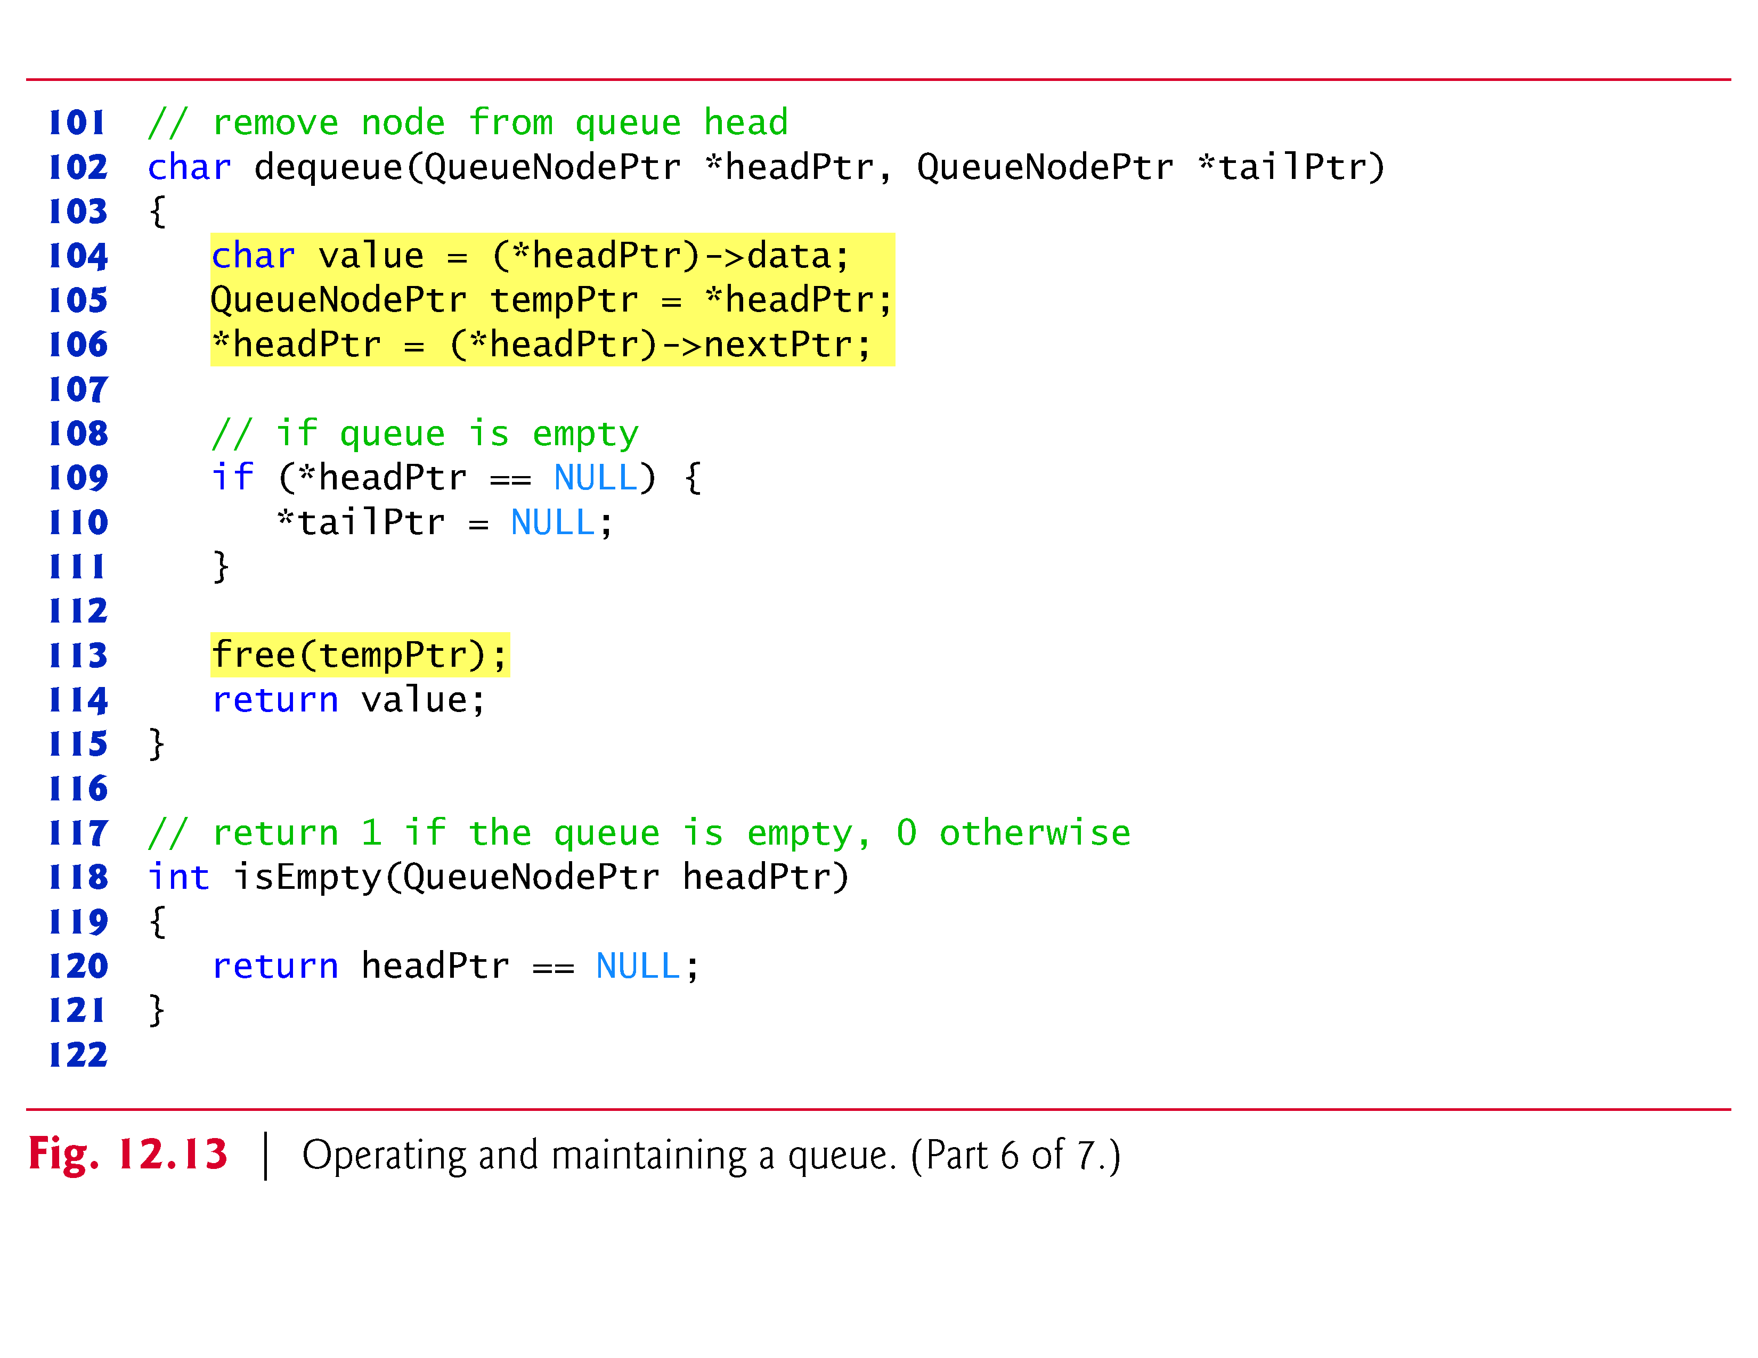

Slide 62
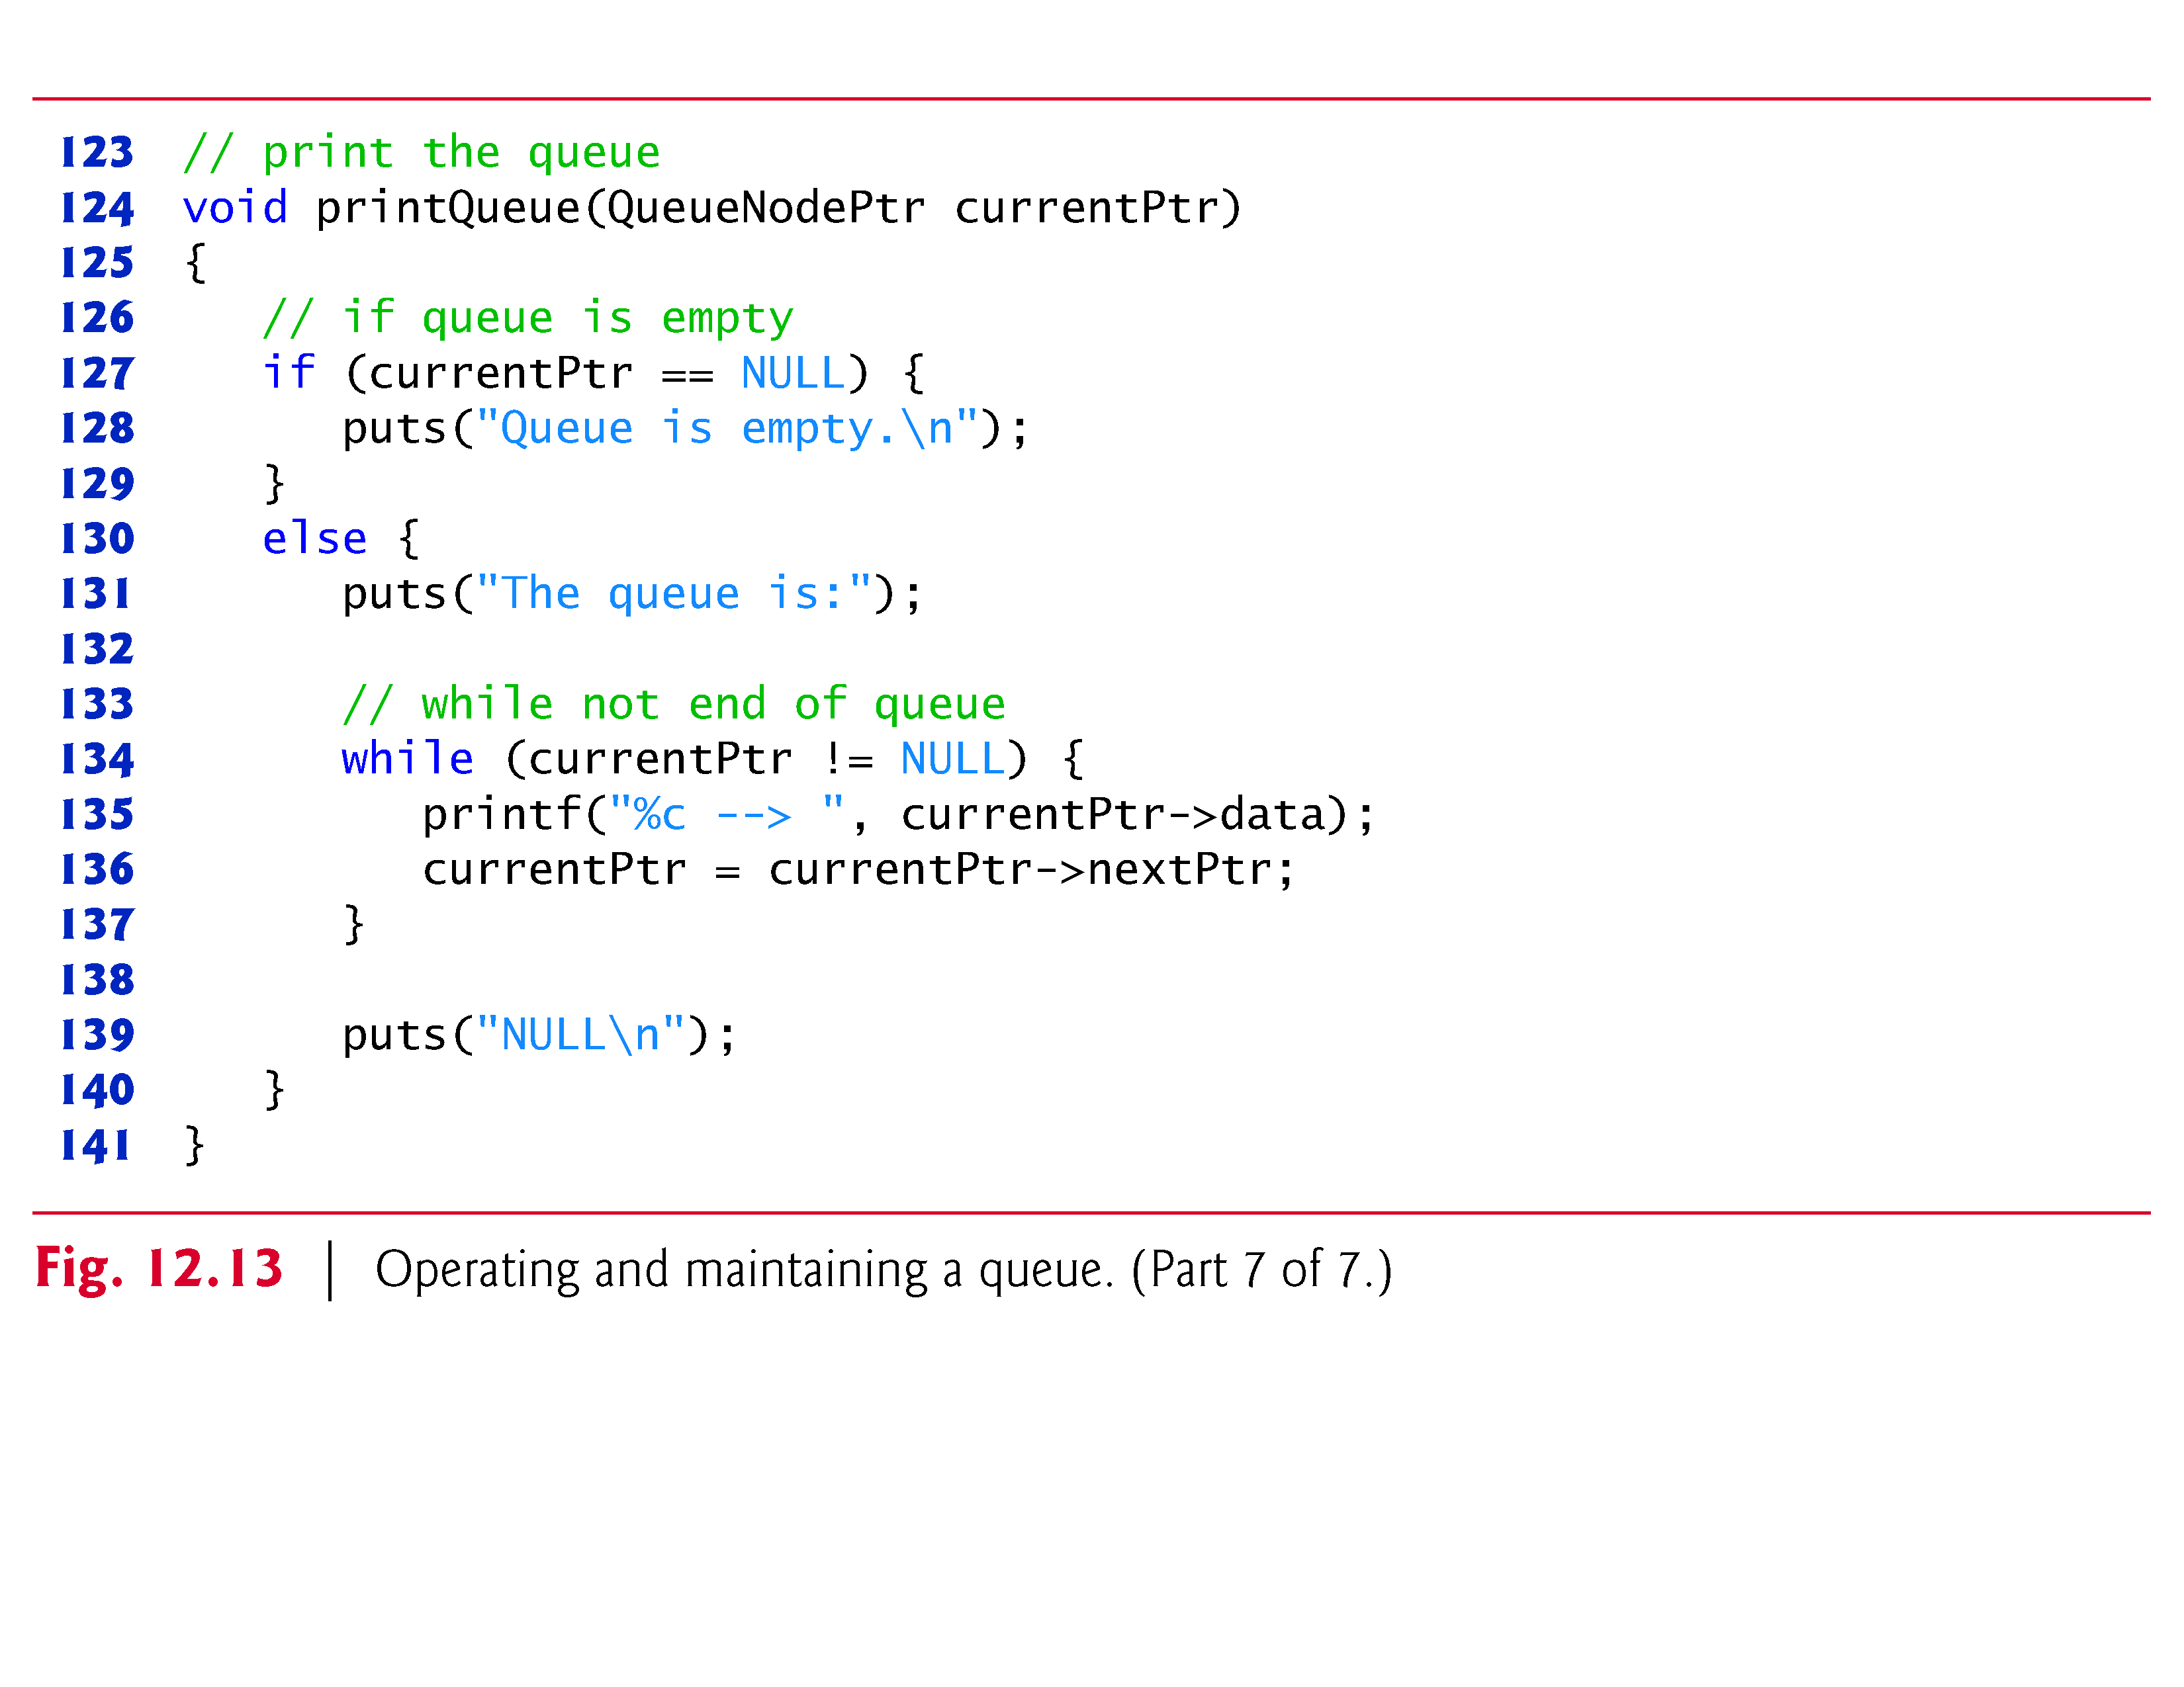

Slide 64
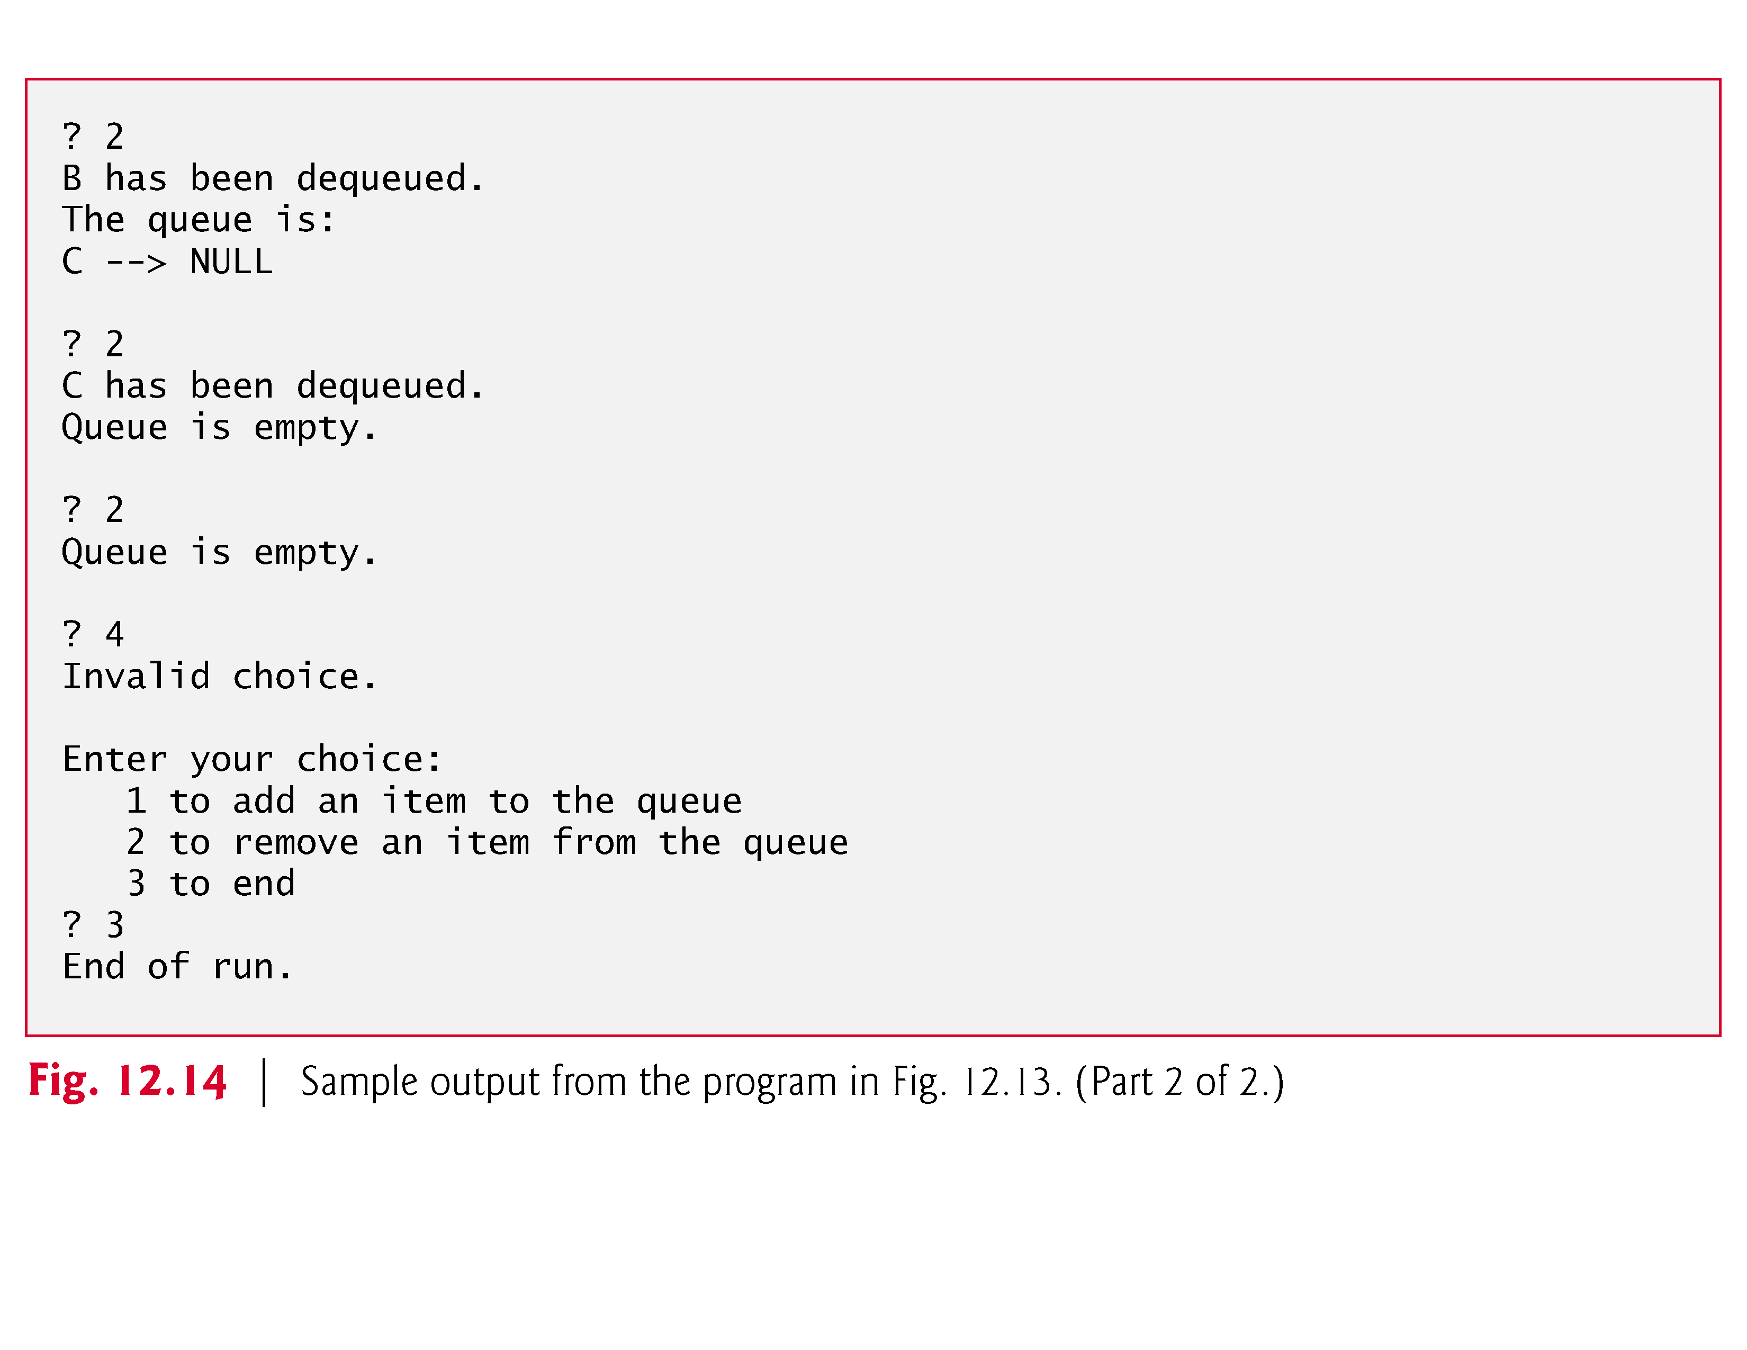

Slide 65
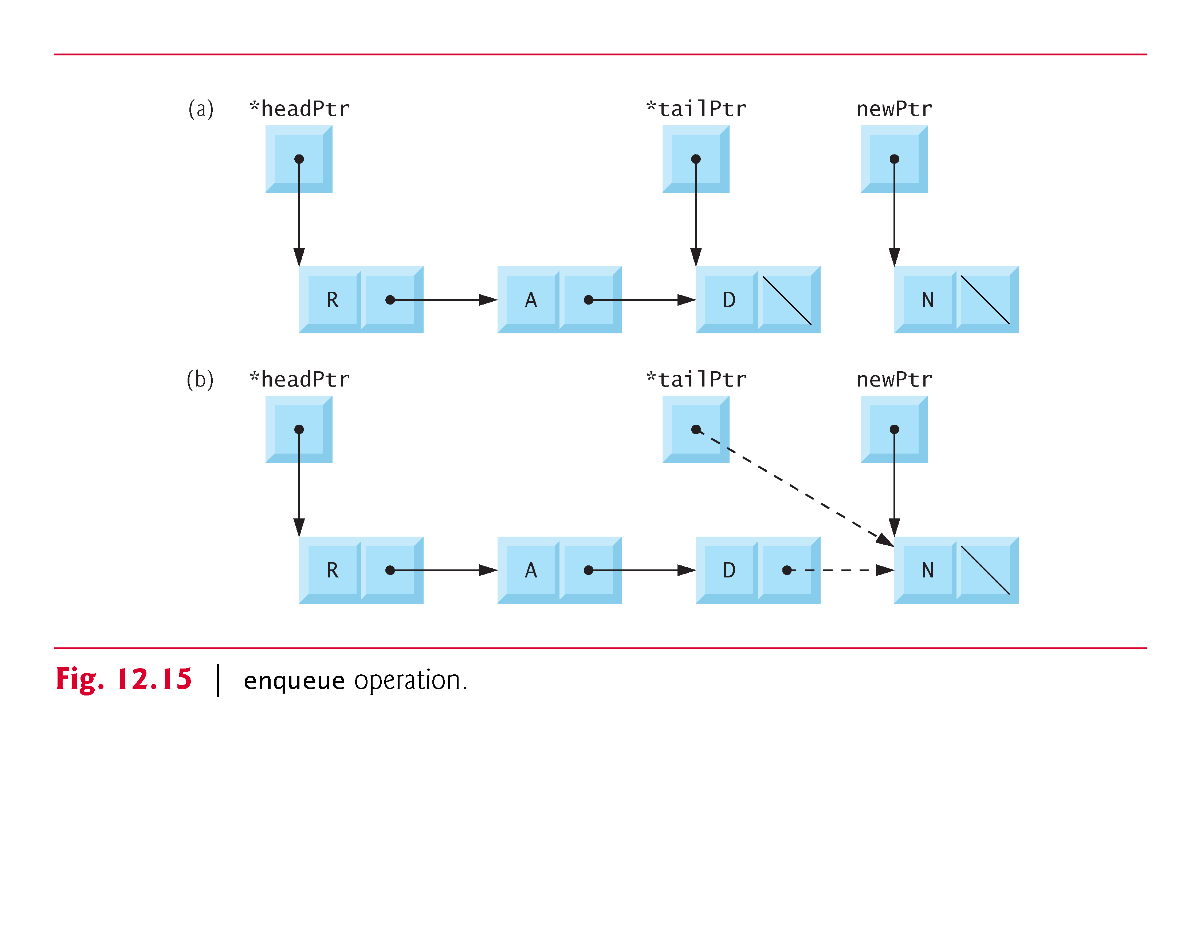

Slide 66
